Slide 1
Doing Business with your Local Government
Michael McClue
WA Local Government Association (WALGA)
Notes:
EMRC
Intro of people

Slide 2
WALGA
WALGA: Working for Local Government
WALGA's key focus is working for Local Government in Western Australia.
As the peak industry body, WALGA advocates on behalf of 138 WA Local Governments.
We are not a government department or agency.
Provision of Advice and Advocacy for members in the following areas:
Community Development | Employee / Industrial Relations
Environment | Governance and Strategy
Infrastructure | Planning
Waste | Roadwise
Notes:
Michael
Who is WALGA?
WALGA is the peak industry body for Local Governments in WA – we advocate on behalf of and work for 139 WA LG’s – Not all LG’s are members.
It’s important to note that WALGA is not a government department or agency, we are a private organisation with the explicit purpose of supporting and servicing our members
WALGA provides multiple services for members including…

Slide 3
Quote Based Purchasing
Up to 90% of expenditure by Local Governments under the tender threshold ($150,000) in accordance with Local Government purchasing policies:
Direct purchase
Tender Exempt Options, Including:
WALGA PSA
CUA
Awareness of aggregated category spend!
$150k
Notes:
Michael
Quote purchasing accounts for the majority of LG spend
LG Purchasing Policies will apply and may be direct, informal or written quotes, dependant on policy.
The same principals apply – but in a less formal way
Quote processes also include quotations undertaken through PSA’s or CUA’s.
Much more flexible and more opportunity to reduce process costs and time and secure real value – not as rigid as tender

Slide 4
Quote based Purchasing
Commitment to the Local Supply Market for certain goods and services
Regional Price / Local Preference
Value for Money focus
Encourage suppliers to become WALGA Preferred Suppliers
Notes:
Michael
VFM – as per the LGs policies and processes
There are circumstances where an LG may utilise Regional / Local pricing preferences for tenders over the $150k threshold, but this is not utilised for Metro LG’s. Regionals
If you are using a supplier who’s not under a PSA, but could be, let us know! Dale will get into more detail later.
Some LG’s are utilising their own panels under eQuotes.

Slide 5
Local Government Tendering
Governed by the Local Government Act 1995 and associated Regulations
Department for Local Government is the regulator
$150,000 tender threshold in WA
(increased in October 2015)
All Local Governments must have a Purchasing Policy
WALGA provides a comprehensive procurement service to Local Governments
Exemptions exist via WALGA PSA’s and CUA’s
Notes:
Michael
It’s important to recognise that LG’s are bound by legislation, for the purpose of purchasing we are bound by the LGA 1995 and regs…
The Regulations cover:
commencing tenders
public notices advertising tenders
minimum duration of calls for tenders
selection criteria
tender documentation information
tender register
minor variations prior to entry into Contract
Understanding The $150k threshold
Always Ex GST
Not limited to one supplier, but a type of good or service
No Time Limitations – for as long as the good or service is reasonably required
Exceptions include:
Declaration of an Emergency;
WALGA Preferred Supplier Arrangements or State Government CUA’s ;
Under auction which has been authorised by Council;
Petrol, oil, or other liquid or gas used for internal combustion engines;
Any other exclusions under Regulation 11 of the Local Government (Functions and General) Regulations 1996.

Slide 6
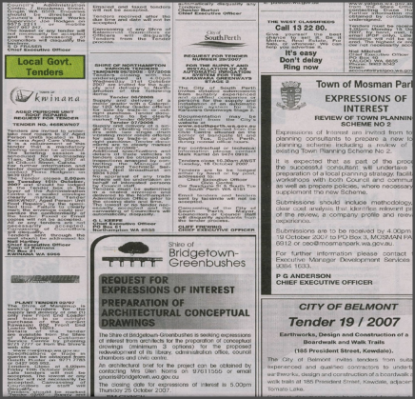
Request for Tenders (RFT) – Tender Notice
Regulations require advertisement of Tenders in a State-Wide newspaper
Notes:
Michael
Tenders start with a Tender notice – paper and more LGs (& WALGA) are posting online too
Regulations require advertisement in a state-wide newspaper such as The West Australian on a Wednesday or Saturday.

Slide 7
Request for Tenders (RFT) - Structure
Request
Specification / Brief
Tenderer’s Response
General Conditions of Contract
Appendices
Annexures
Form of Contract Award
The Rules
The Requirements
The Information
The Framework
Notes:
Michael
Tender (RFQ or RFT) documents are made up of a number of components, these include:
Request – sets out the rules. The Principal and all Tenderers have to adhere to these rules once set – THE RULES
Specification/Brief – provides specific details of the requirement of the goods and/or services – THE REQUIREMENTS
Tenderer’s Response – specific information required by the Principal (ie identifying information) – THE INFORMATION
General Conditions of Contract – provides the framework for the supply contract – THE FRAMEWORK
Appendices – May include plans, Local Government policies etc;
Annexures – Conditions of Contract Annexures ( e.g. Australian Standards etc)
Form of Contract Award – e.g. Instrument of Agreement, Letter of Engagement etc.
Key things you want to know about is how to come through this process as the successful tenderer – so I will concentrate on informing you about the tender process and then how to put your best foot forward

Slide 8
Evaluation Criteria
Evaluation Criteria - set before publishing of Tender
Compliance Criteria - must be met by all Tenderers (non-weighted)
Qualitative Criteria – basis for evaluating Tenderers (weighted)
Regulation 14, Local Government
(Functions and General) Regulations
Notes:
Michael
Within the request, there are a number of assessable criteria – these are part of what make the suppliers offer to you:
Evaluation Criteria
Compliance… Yes or No – Meets or does not meet.
Qualitative… There is flexibility around the weightings and selection criteria – depending on value and what is being purchased

Slide 9
Evaluation Panel
The Evaluation Panel will typically consist of:
Two or more people
Balance of knowledge e.g. technical, finance, procurement, etc.
The City’s Contracts Officer as process facilitator
Evaluation Manager / Chairperson
Notes:
Michael
It is important to remember that there will be a mixed bag of knowledge and experience – so don’t take anything as given.
EP will usually have at lEastern one subject matter expert, and usually will have others who don’t know much about the process, so don’t assume that they know what you mean (acronyms and industry lingo are good examples)
The panel will have various perspectives and priorities – results in balanced evaluation – but you need to take this into account when constructing your response, put it in a way that anyone could understand.

Slide 10
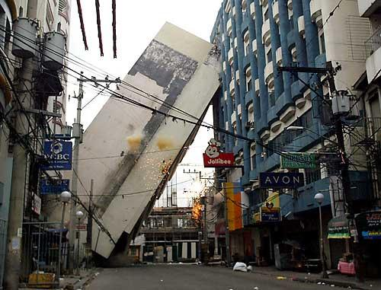
Evaluating Tenders
Selecting the right supplier is more than just the best price!
Notes:
Michael
How are tenders evaluated?
Tenders are evaluated against the Evaluation Criteria for the ‘most advantageous’ (terminology per regulations) offer to be accepted.
This will be the offer that best meets the needs of the council, for the best possible price.
It is not price alone, and price is usually considered after the qualitative assessment.
Some interesting contract management discussion as a result of the photos above.

Slide 11
Tender Evaluation
Evaluation Criteria
Value for Money means price is usually non-weighted and excluded from the qualitative assessment
Compliance Criteria
Is it met, compliant or not. Not subjective.
Qualitative Criteria
Criteria should be weighted, panel scores and weighted accordingly.
Notes:
Michael
Tenders are generally evaluated based on ‘Value for Money’ This does not mean the lowest price – in fact price is usually an secondary evaluation.
Looking for what best meets the requirements, at the best price.
Compliance Criteria – Qualitative Criteria – Price
Important to read and follow the instructions with regard to offer, especially pricing for a fair evaluation.
If you want to offer in a different way, you may be able to – ask, but make sure its in addition to what’s required, not in replacing what’s required.

Slide 12
Tender Evaluation
Price Evaluation:
Offered pricing must meet the requirements as specified in the Request.
Assessment of price will include consideration of Total Cost of Ownership, including:
Notes:
Michael
Tenders are generally evaluated based on ‘Value for Money’ This does not mean the lowest price – in fact price is usually an secondary evaluation.
Looking for what best meets the requirements, at the best price.
Compliance Criteria – Qualitative Criteria – Price
Important to read and follow the instructions with regard to offer, especially pricing.
If you want to offer in a different way, you may be able to – ask, but make sure its in addition to what’s required, not in replacing what’s required.

Slide 13
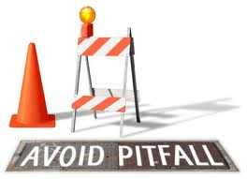
Key Issues with Submissions
Rely on reputation
Make unsubstantiated claims
Provide an inappropriate level of detail
Display lack of care and effort
Rely on templates
Local entitlement (Buy Local)
Notes:
Michael
Relates to tenders and quotations – from panel of WA LG evaluators
Suppliers either glaze over or think it relates to other people – but the majority of tenders evaluated need improvement…
Note: small / local suppliers normally do the best job of submitting – more flexible and more likely to work from scratch which means a tailored and appropriate response
ANY IDEAS WHAT THE KEY ISSUE MIGHT BE?
1. Reliance on reputation
Undermine the process through attempts to influence decisions (Council / officers, etc) – canvassing may jeopardise your right to tender
Presumptions and expectations – can have opposite effect (make evaluator think you are not interested in the job)
Over confidence can backfire
2. Make unsubstantiated claims
Big words but nothing to back it up – give examples the panel can relate to whenever possible
Don’t pad out – be authentic and succinct
3. Level of detail
Too brief / too much information – enough to give confidence to panel but not too much that they get bogged down / bored / lost in irrelevant info
Don’t presume that gaps can be filled in later – or that negotiations can happen later – understand that there may not be second chance so important to put best foot forward at this stage – LGs not allowed to negotiate on price in a tender so offer best price (they can negotiate under WALGA / quotes)
4. Display lack of care and effort
Missing compliance details / Some qualitative criteria not addressed
Not considering the buyers perspective / requirements – what do they actually want / need from us? Eg consider the weightings and target your responses accordingly
Referring forwards or back
Not allowing adequate time
Not following instructions – eg attachments in certain formats etc.
Layout – make it easy to navigate (i.e. the flow) and understand
Review the Ts and Cs and the insurances - and provide details of any departures – do not rely on later negotiation opportunity. If legal review is needed do it at this stage.
5. Rely on templates
Efficient but…certainly not the key to success
Capability attachment as ‘catch all’
Not providing information that is specific
Referring back and forth – or ‘as I have previously explained’
Either attaching the whole template – or cutting and pasting from it
Evaluation Panel finding other names from previous offers in this one.
6. Assume that local suppliers will win
Sometimes local suppliers might assume that they are a ‘shoe in’ for a job – this isn’t the case, metro will not have buy local requirements and sometimes the regional ones may provide a benefit, but this doesn't mean that it’s a given. Likewise, don’t be put off tendering for a regional job, even if there’s a buy local / regional content component.

Slide 14
Key Tips on Preparing Responses
Focus on the Local Government’s needs
Take into account the regulations & the particular Local Government’s purchasing policies & processes
Match your offer to the opportunity
Look at the weightings
Address the Sub-Criteria
Be succinct!
Understand and focus on VFM
It’s not just the lowest price
Notes:
Michael
Top Tips from the experts – ie a panel of evaluators – how to win a tender
Like tightrope walking – keep eye on the prize, balance between requirements – don’t fall into the traps
Focus on the Local Government’s needs – address what they need – put yourself in their position (and the position of the evaluator – remember the mix of evaluators) – address all the compliance reqs – and each of the qual criteria
Take into account the regulations and the particular Local Government’s purchasing policies and processes – eg just make contact with the nominated personnel – eg follow the lodgement instructions (late tenders cannot be accepted due to the underlying regs – ie not the LG issue) and don’t leave to the last minute (or even hour) – eg address all the compliance requirements (non negotiable)
Usually available on a councils website, or just ask.
Match your offer to the opportunity – in terms of level of detail as well as content
Focus on Value for Money – understand the concept and ensure you demonstrate what additional value would be achieved through your offer (spell it out clearly) – what gives you the edge over your competition? If there are any additional discounts available then make sure you state what they are – explain what value your price offers rather than just the price in isolation.

Slide 15
Any Questions?
Notes:
Dale
Just remains for me to wish you every success now that you have been guided through the LG Procurement maze

