Slide 1
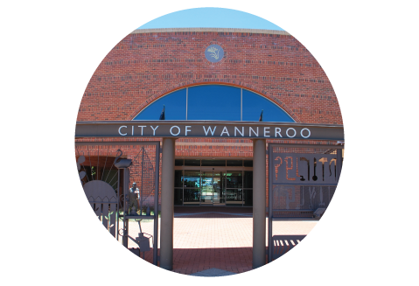
Doing Business with the City
David Best
Manager Contracts & Procurement, 7 March 2017

Slide 2
Purpose of Today’s Presentation
Identify the nature of the purchasing spend undertaken by the City;
Outline the Local Government rules and the City’s purchasing process; and
Explain how local businesses can get involved

Slide 3
Procurement Spend Profile
$130m+
expenditure per annum on goods, services and capital works projects
200+
public tenders and formal request for quotations issued per annum
40,000
purchasing order items per annum
1,640
active suppliers
Notes:
The numbers speak for themselves - we are a busy Council in terms of procurement activities and find ourselves under constant scrutiny in terms of potential for fraud and misconduct from an audit perspective
There is definitely scope for further analysis of the spend
And to develop a more strategic focus to cost savings and improvement in procurement practice
Procurement can absolutely be an active contributor to bottom line savings and enhance the supplier relationships
Having said that the focus is very much on continuing education and training given the volume of activity occurring and the degree of competency generally

Slide 4
Nature of the Spend
$8 million
$4 million
Parks and Conservation
Capital Works
Building/Facilities Maintenance
$80 million
$4 million
$4 million
$17 million
Fleet
Traffic Management
$3.5 million
Waste

Slide 5
Nature of the Spend
Nature of the Spend (Cont…)
Other Categories

Information Technology and Communications
Professional Consulting
Temp Personnel
Advertising
$2 million
$2 million
$2.5 million
$750 k

Plant and
Equipment Hire
Office Products and Consumables
Catering, Hospitality and Events
Printing
$500 k
$200 k
$500 k
$500 k

Slide 6
Why Buy Local?…
Benefits of Buying Local
Aspiration: Progressive, connected communities that enable economic growth and employment
Buy Local Initiative to solidify support for local businesses and enhance the City’s focus on transformational initiatives
Promote local economic growth and development
2016
2031
49,000 local jobs
96,000 local jobs
Key Economic Strengths:
Large and growing population base
Key strategic employment locations
Vibrant employment centres
Available and affordable land

Slide 7
Buy Local ‒ Part of Broader Corporate Social Responsibility
Notes:
City has a responsibility and a policy requirement to incorporate considerations for better sustainable outcomes when undertaking procurement.
This includes:
Buying from WA Disability Enterprises (next slide talks in more detail)
Buying from aboriginal businesses
Buying from social enterprises
Buying locally

Slide 8
City’s Commitment to Buying Local
Nature of the Spend (Cont…)
“Buy Local” Questionnaire included in Request for Quotation and Request for Tender documents…
“The City of Wanneroo is committed to supporting local business and adding value to our local economy through our monetary spend on City purchases. This commitment includes, but is not limited to”:
Marketing and promoting quotation, tender and expression of interest opportunities to local businesses
Using local businesses and sub-contractors for City purchases
Purchasing locally made and sourced goods and services
Using companies who employ local residents and sub-contractors

Slide 9
Why do Business with the City?
What makes the City of Wanneroo attractive to supply to?
Stable/predictable requirements
Good forward planning
Opportunity for growth and long life expectancy
Trusting relationship
Payment Terms adhered to
Simple, straightforward systems and processes
Easy to respond to (offers), easy to service
Offering opportunities that can be accessed by all markets
Notes:
Ask the Audience: What does the supplier look for in a supply partner, such as the City of Wanneroo? What do you think they are saying about the City?

Slide 10
Local Supplier Procurement Profile
Why Do Business with the City?
Average 6 monthly procurement profile

Slide 11
Procurement Rules and Regulations
Local Government Act 1995 and the (Functions & General) Regulations 1996
City’s Purchasing Policy
Statement of Business Ethics
Delegations of Authority Council, CEO and Others
Management Procedures
−


−
−

Slide 12
The City’s Purchasing Policy
Requirements…
Up to $5,000
Purchase direct from suppliers where purchase value is up to $5,000...
$5,001 - $150,000
Seek competitive quotations where value is between $5,000 and $150,000
Above $150,000
Seek public tenders where value is above $150,000
Exemptions from calling public tenders exist (e.g. where a WALGA or State Government preferred supplier program exists)

Slide 13
Procurement Process
Procurement Planning
Supplier
Sourcing
Supplier Evaluation
Recommendation Report
The City operates under a Centre-led procurement model
Administers structured and defined procurement processes
Formal approvals are obtained from Council or under Delegated Authority
Notes:
There are four general phases of a supplier selection process (talk through).
We’ll be providing an overview of each of these steps in this module.

Slide 14
Value for Money Application
Price and Total Cost of Ownership
Technical Merits satisfied
Contractual compliance
Supplier experience/financial viability
Methodology and capacity to supply
Safety management and quality considerations
Contribution to corporate social and sustainable objectives
Active encouragement of local business opportunities
solution
business
excellence
development
experience
design
team
increase
concept
value
approach
provide
costs
best
product
company
system
honesty
new
business
customer
order
project
Notes:
Total Cost of Ownership – principle that refers to understanding the total cost, including acquisition plus all other costs associated with possessing the good/service acquired.
Technical merits – meets the prescribed need.
Contractual Compliance – demonstrated agreement with contractual framework
Financial viability / capacity to supply – ability to service the contract
Strong element of competition – competitive tension leads to better value outcomes
Safety – does the proposal satisfy City’s safety requirements? Is an adequate safety management system in place? Does the bidder come with a good track record in managing safety?
Sustainable objectives – does the product / service meet triple bottom line objectives? Note – pre-requisite versus consideration.
Local Business Opportunities – particularly relevant for LG – does buying from the supplier contribute to stimulating the local economy?

Slide 15
How to Get Involved
By direct sourcing – make yourself known to the City…(present your credentials and understand the City’s requirements)..
By invitation to quote – usually issued by the City through its e-tender portal request, email requests or through preferred supplier programs such as WALGA e-quotes panels; or
By responding through a public expression of interest or tender process (e-portal)…

Slide 16
Upcoming Procurement Opportunities
Quotes/Tenders to be requested prior to December 2017:
Fit Out of Civic Centre Extension and Refurbishment of existing building
Ridgewood Park Meeting Room Extension
Park and Streetscape Maintenance
Traffic Management/Control
Supply of Cement Pavers
Linemarking
Plant Hire
Catering
Fencing

Slide 17
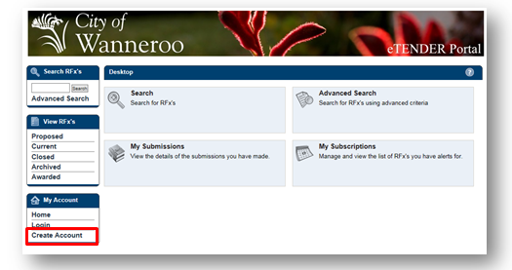
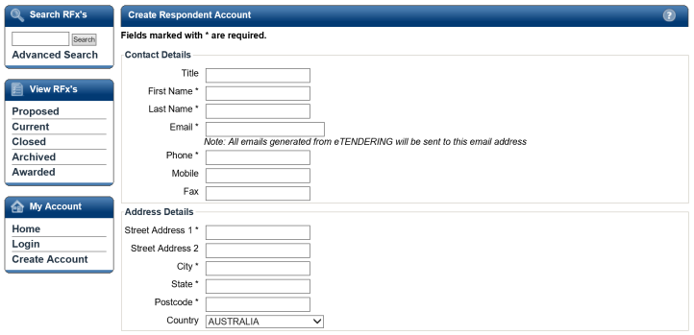
Register on the City’s e-Tender Portal
To use our new E-Tender portal, you will need to register (your business).
With the eTender portal you can receive the latest information on tenders currently being advertised and awarded, and monitor and submit responses.
To register go to the eTender portal (on the City’s website (www.wanneroo.wa.gov.au) listed under Tenders and Contracts).
From the My Account widget select Create Account.
Complete your details on the Respondent Registration page. (All * fields are mandatory).

Slide 18
Do’s and Don’ts of Submitting a RFx

✗
Do
Don’t

Do submit your response on time
Do read and comply with the RFx instructions
Do complete all of the questions
Do supply all necessary supporting documentation (ie. insurances, price schedules)
Do seek clarification if needed
Do ask more for more time, if needed
Don’t submit a late response (if you miss the deadline, you will not be considered)
Don’t omit the Price Schedule
Don’t submit unnecessary documentation (this will only slow down the evaluation process)




Slide 19
Where to for More Information?
?
City of Wanneroo website: http://www.wanneroo.wa.gov.au/
Search Tenders and Contracts
Email: Contracts_purchasing@wanneroo.wa.gov.au
OR
eTender Portal Queries
Sophia Kantcheva
Contracts Administration Officer
Phone: (08) 8405 5671
Email: Sophia.Kantcheva@wanneroo.wa.gov.au


Slide 20
Questions to Follow…
Notes:
Best wishes to all for the festive season!

