Slide 1
Wanneroo Global Connect Series
Smart Cities Masterclass
Strategic Futures & Opportunities for Wanneroo
Ideas & Thoughts
Jim Singleton, City of Wanneroo

Slide 2
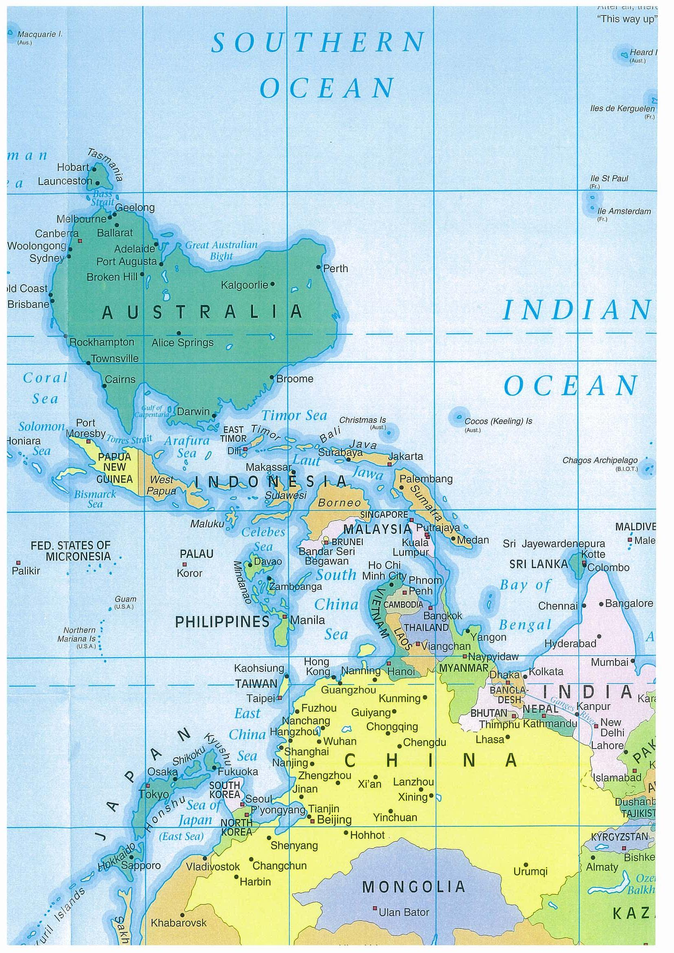
“If you want to do things differently, you’ve got to look at things in a completely new way”
Global economic hubs
Turning assumptions upside down is a good way to start…..
Rising global cities
Time zones (+ or - 1 hr)
Regional flows:
FDI
elite commuters
business networks
materials
products
resources
innovation
knowledge
expertise
values
Ref: Worldwide Centres of Commerce Insights (2007), MasterCard

Slide 3
Q: What are Wanneroo’s Comparative Advantages?
Low sovereign risk
Same time-zone as Asia Hemisphere rising
World-class ocean and environment
Coastal setting for development
Food security and high value primary products
Proximity to Central Coast and Western Wheatbelt
Greenfields development potential for +100 year strategic infrastructure
Substantial ‘internationally significant’ conservation estate
Diverse and unique sense of place (e.g. landscapes)
Resilient and diverse community make-up
Rapid growth potential

Slide 4
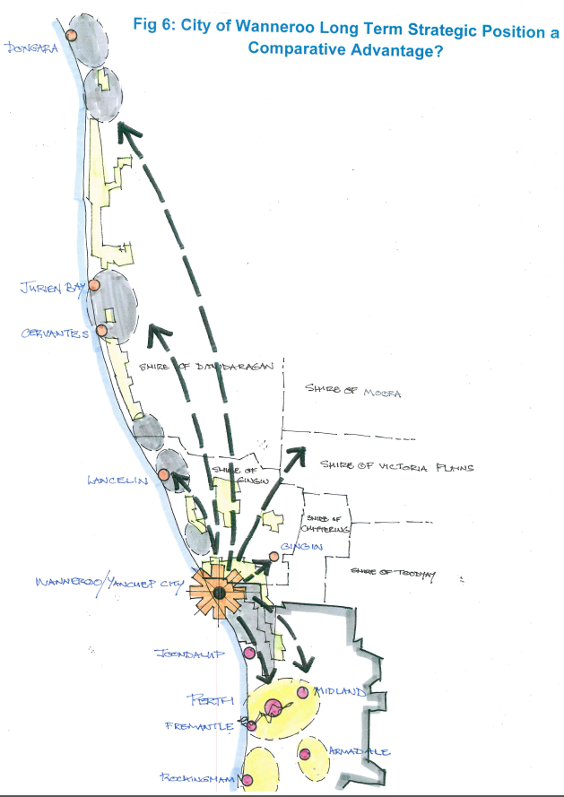
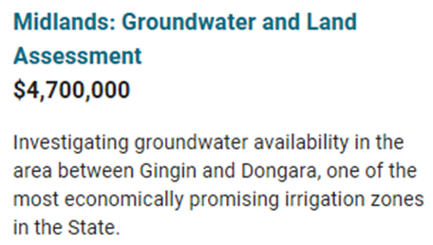
City of Wanneroo Long Term Strategic Position
A Comparative Advantage
Dongara
A region of significant resources and opportunities yet to be fully realised…..
Minerals
Fisheries
Horticulture & farming
Ocean side settlements & tourism
Energy
Groundwater for irrigation
The Central Coast sub-region
The Lower Mid-West and Western Wheatbelt
So, we need major regional linkages!
Wanneroo and Yanchep City
The Perth Metropolitan Region

Slide 5
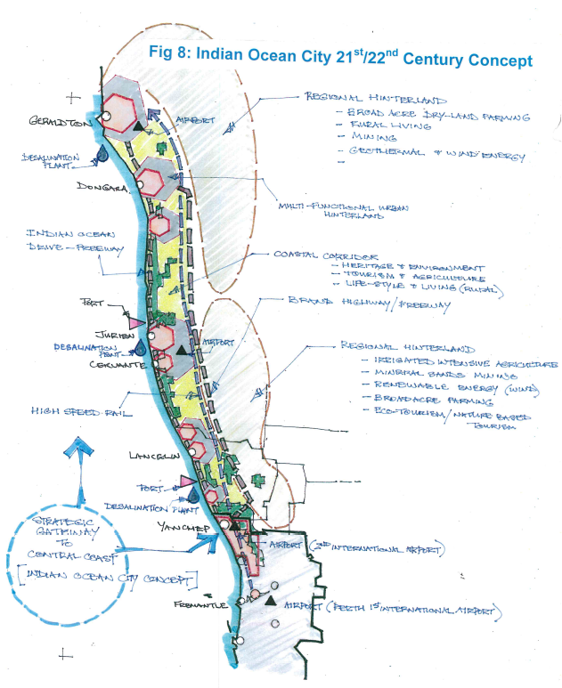
21st Century Indian Ocean City Concept
Geraldton
Part of a potential 22nd Century Mega-Corridor (Geraldton to Busselton)
2nd International Airport
Strategic Gateway Yanchep City
Perth International Airport

Slide 6
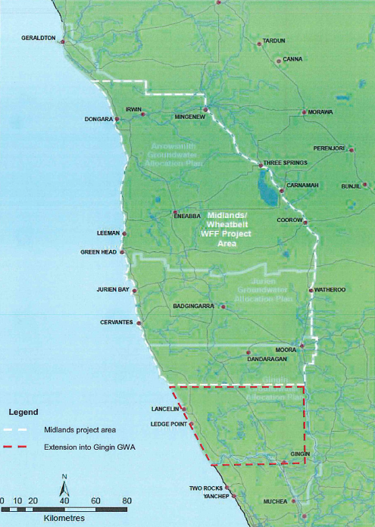
An example of functional regional linkages
Agribusiness/horticulture
Heavy freight haulage routes
Midland/Wheatbelt Water for Food (WFF) Project Areas
RAV 10
Groundwater irrigation investigations and prospects
RAV 7
Road freight transport connections needed
RAV 7
Potential heavy haulage connection to future port
RAV 7
RAV 7
Existing horticulture areas
Heavy freight transfer hub
Possible future port?
RAV 4
Wanneroo-Carabooda Agribusiness Hub

Slide 7
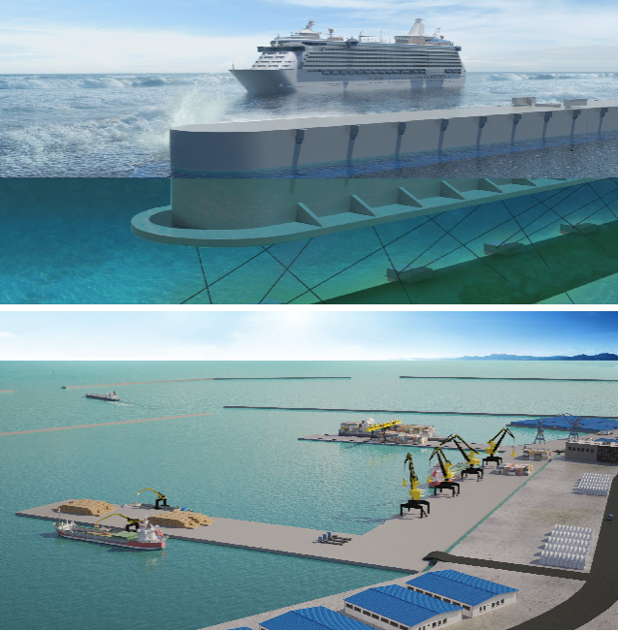
The Middle East Looks to Floating Ports and Villas (Ref: The Maritime Executive)
Innovative engineering for port development and expansions starting to favour floating wharfs, jetties and freight handling areas
Near shore floating ports are a serious prospect
Potential for very low impact environmental ‘footprint’
Combined with driverless, automated, robotic freight handling vehicles & containers - potential to replace conventional approach to port planning design?

Slide 8
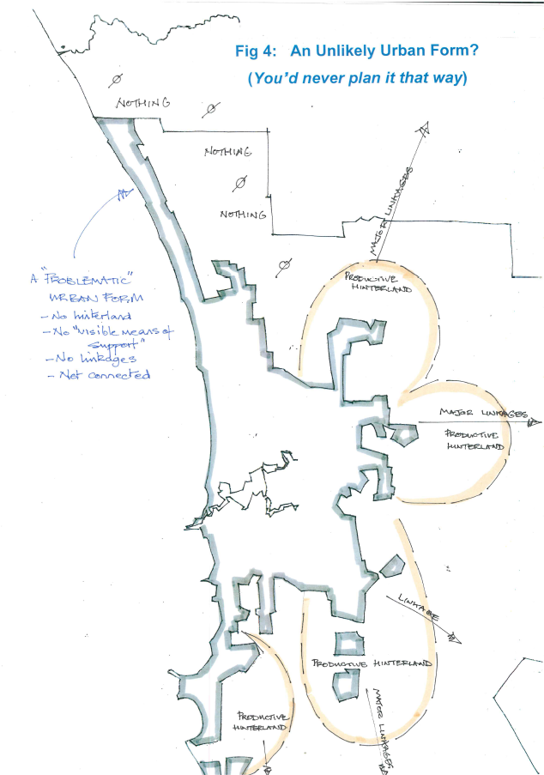
An Unlikely Urban Form?
“You’d never plan it that way!”
A problematic Urban Form
No hinterland
No ‘visible means of support’
No linkages
Not connected
Economically productive hinterlands to other urban corridors

Slide 9
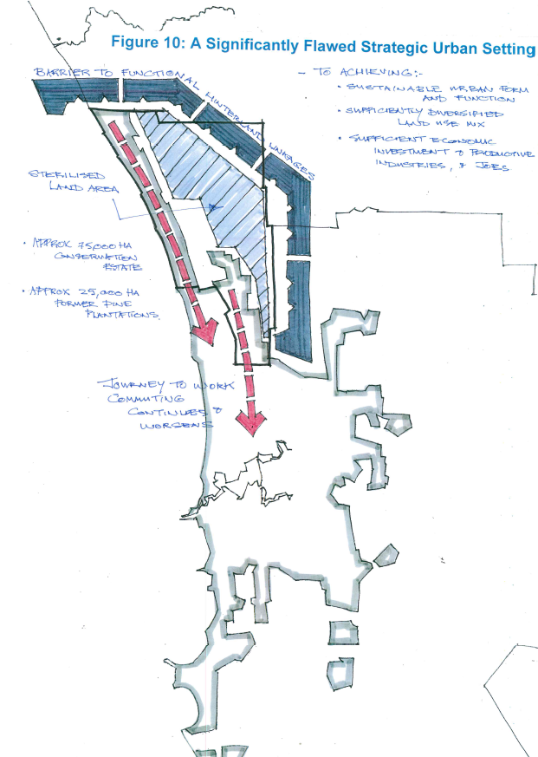
A Significantly Flawed Strategic Urban Setting
Physical barrier
(approx 75,000 ha)
For achieving:
Sustainable urban form & function
Sufficiently diversified land use mix
Sufficient economic investment, productive industries & jobs
Sterilized land area
(approx 25,000 ha)
Without some big solutions..
….more of the same on the cards?

Slide 10
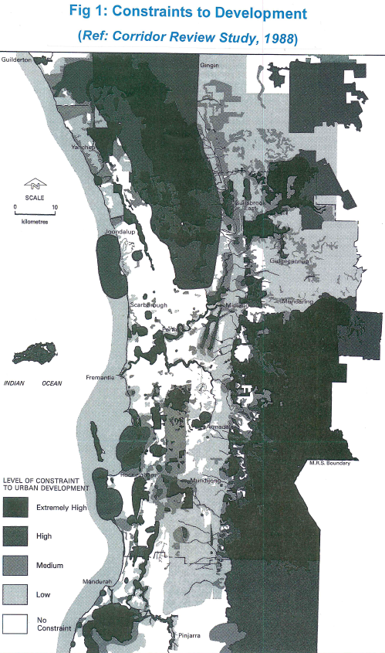
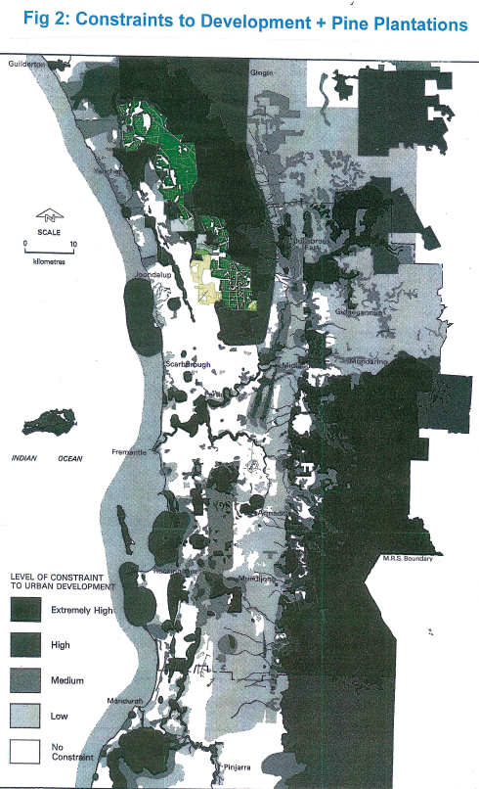
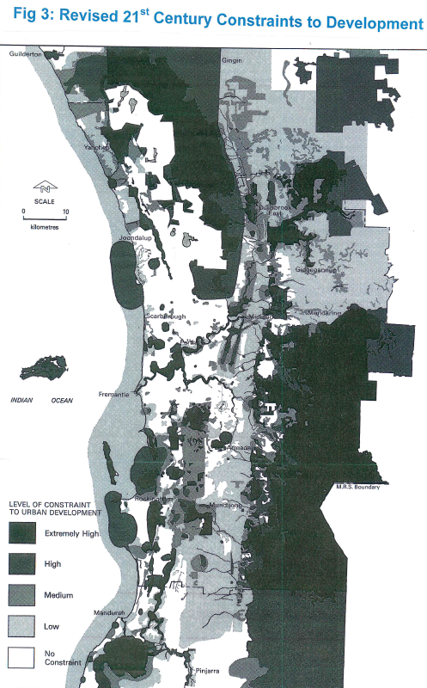
1988 constraints map
Regional Constraints to Development – change over time
Pine plantations harvested & no case for Priority 1 Groundwater Protection over cleared areas remains
2017 constraints map (revised)

Slide 11
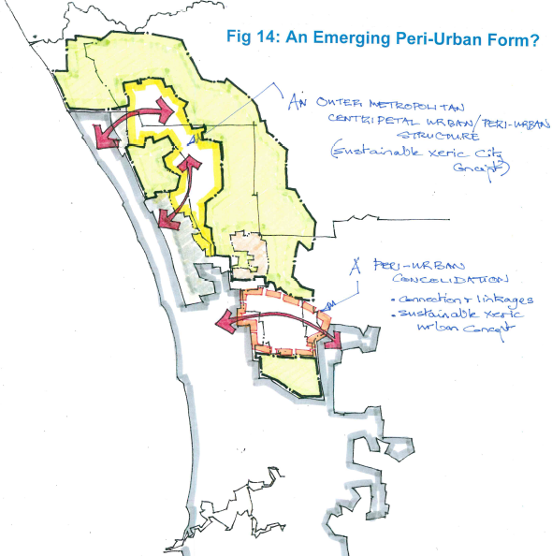
Possibility of an Emerging Peri-Urban Form?
An outer metropolitan Centripetal Urban/Peri-Urban structure
(Sustainable Xeric City Concept)
Peri-urban Consolidation
Connection and linkages
Sustainable Xeric City Concept

Slide 12
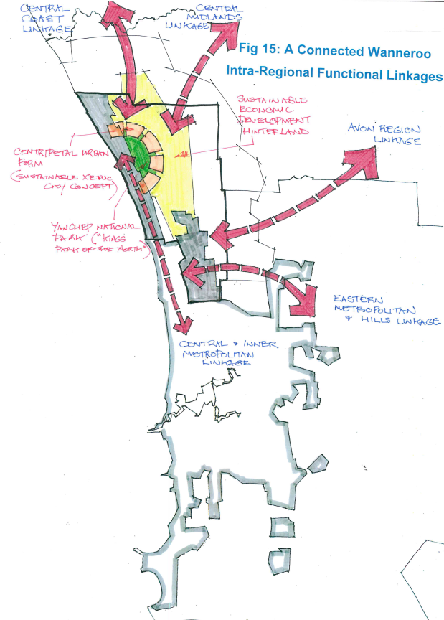
A Connected Wanneroo:
Intra-Regional Functional Linkages and Economic Activity
A Sustainable Economic Development Hinterland
Agribusiness zone

Slide 13
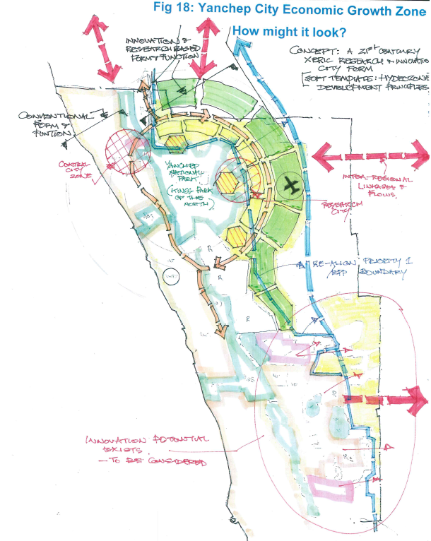
Research and Innovation ‘living laboratory’ urban & non-urban (agribusiness) form and function
Yanchep City Economic Growth Zone
Conventional urban corridor form and function, with progressive innovation and applying Smart City principles
21st Century Xeric Innovation and Research City Concept
‘next generation’ Smart City
‘soft template’ master planning
hydro-zone thinking, planning
renewable & alternative energy
new design and development principles
desalination dependent
Key Concept: developing solutions to help solve world-wide arid zone & arid settlement challenges for humanity

Slide 14
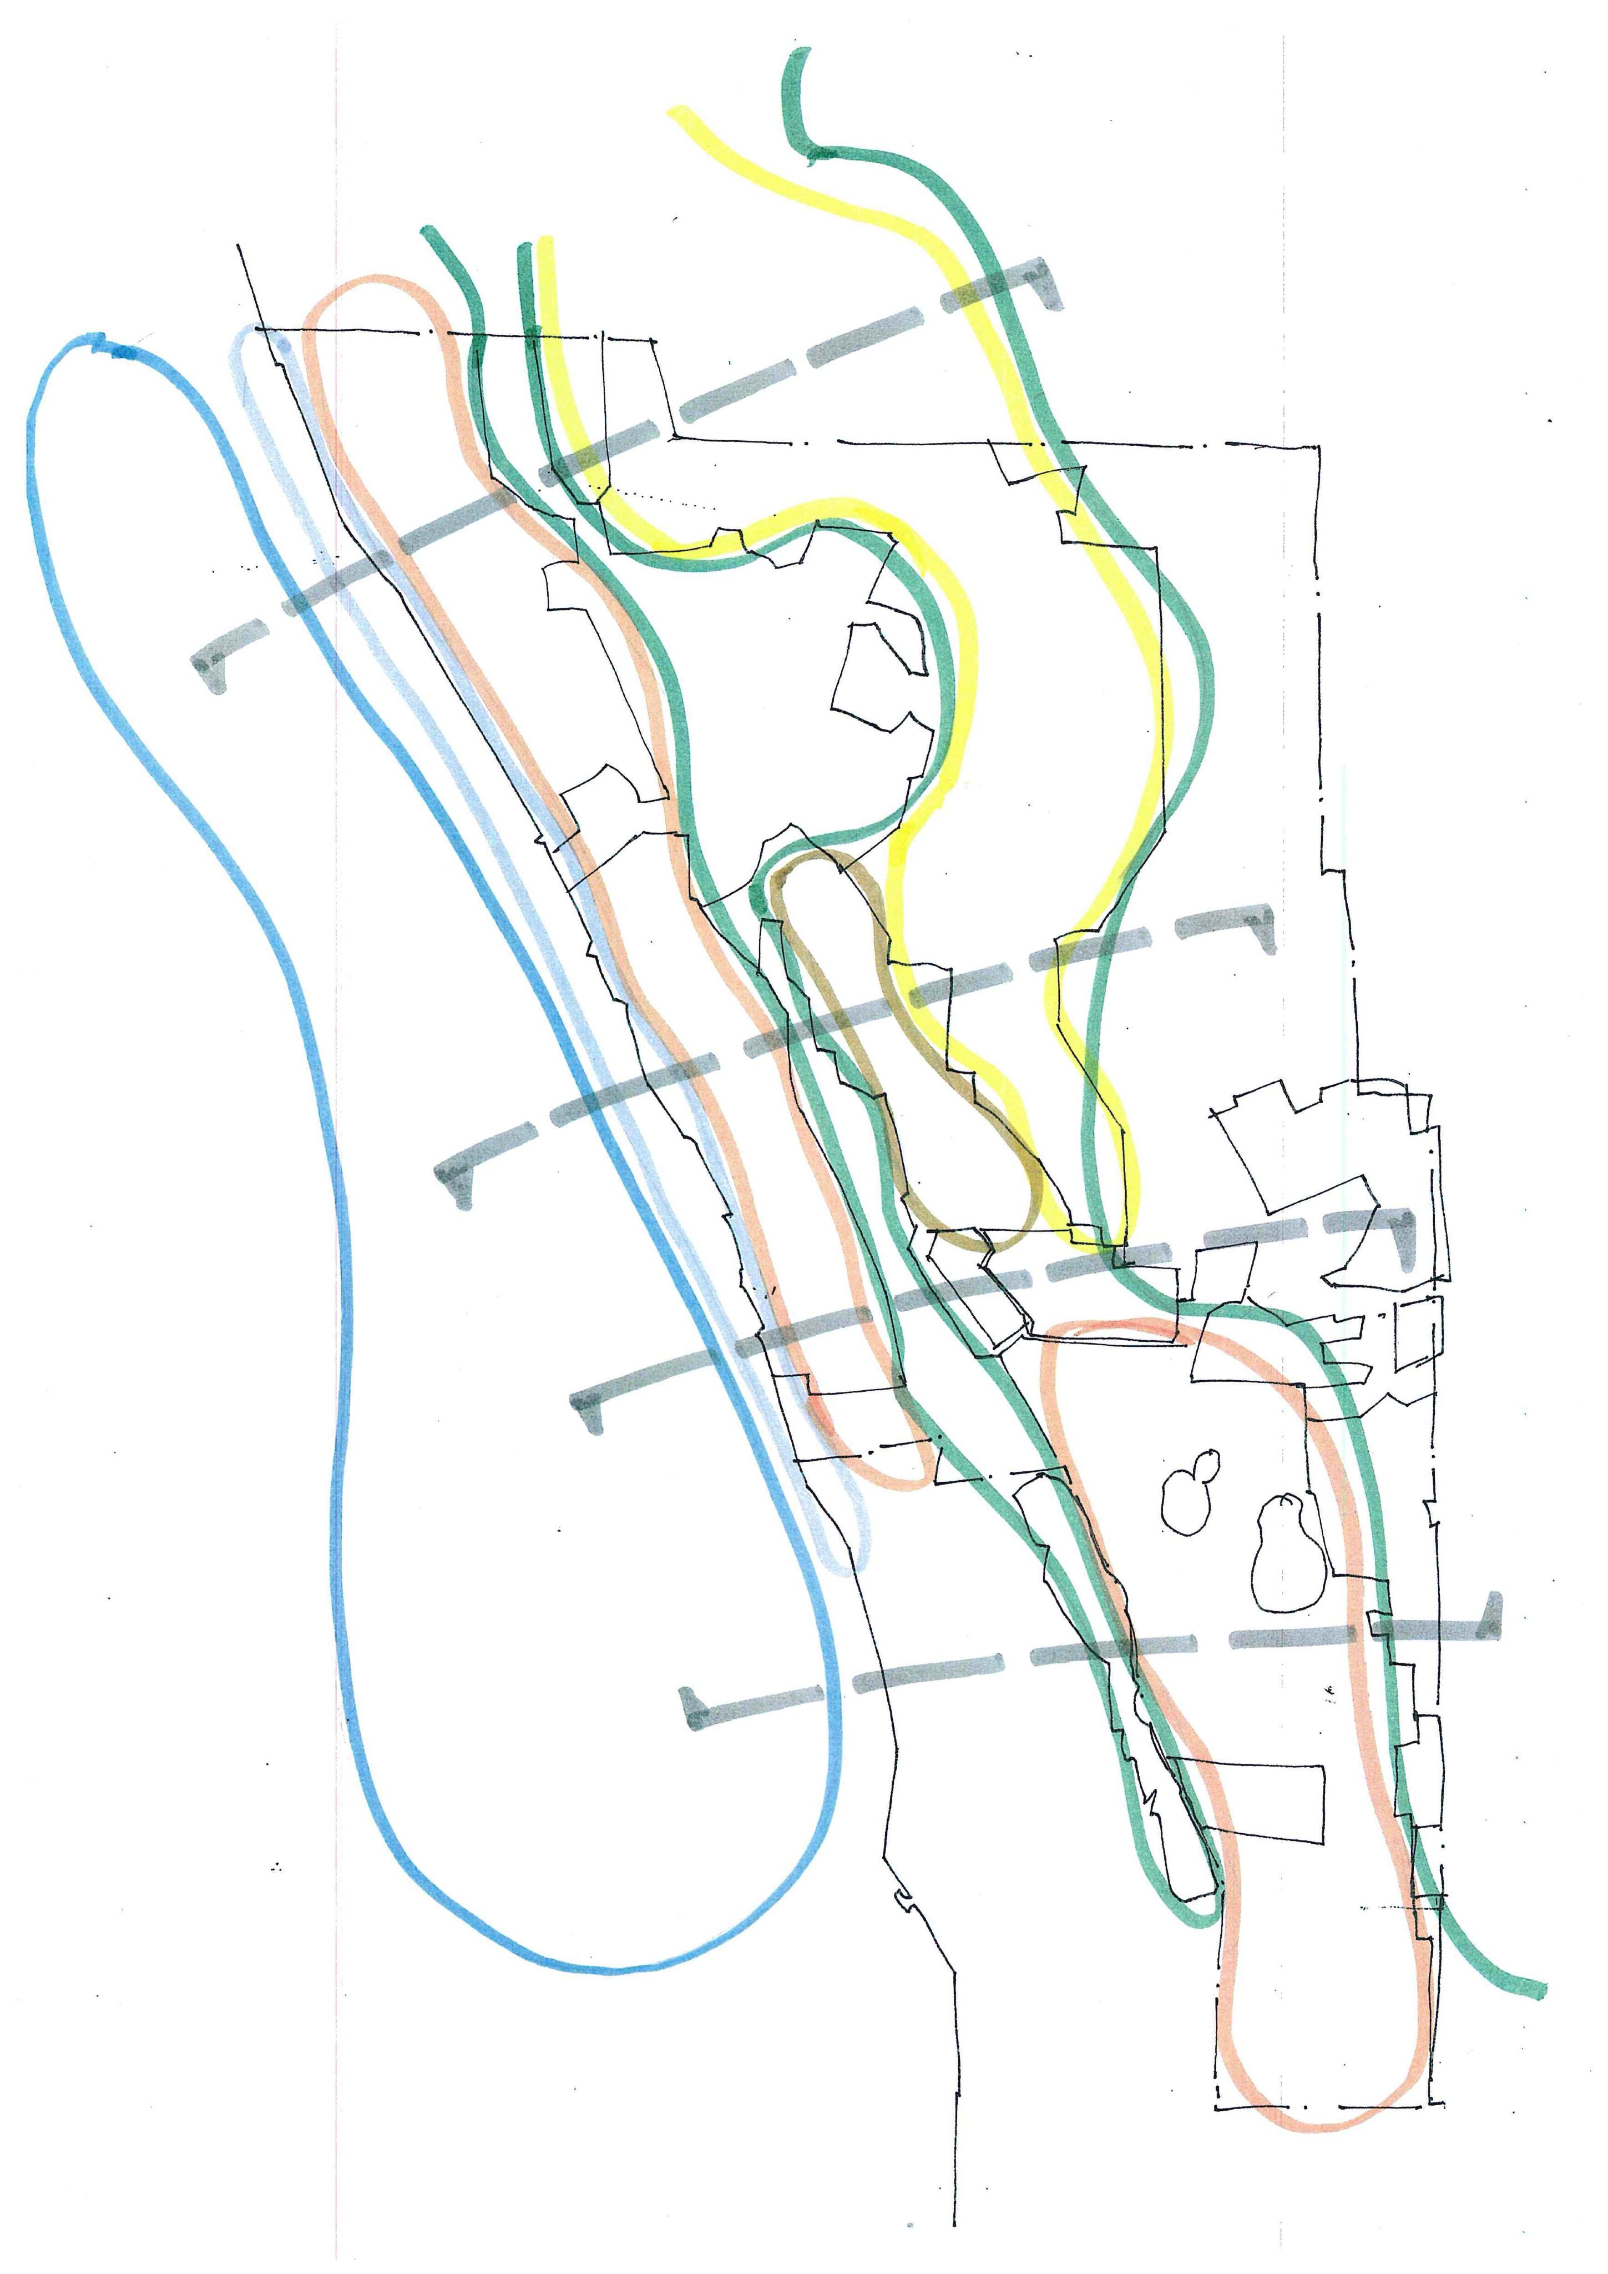
Wanneroo: Comparative Advantages for Smart Economy Enterprise & Liveability
Capitalizing on a ‘sense of place’!
Linear Lakes, National Parks and ROS Zone
Diverse landscapes across the corridor
Open Marine Environment
Strategic Land Bank
Coastal Strip & Near-shore Coastal Zone
Agriculture Horticulture Industry zone
Diverse living zones across the corridor
Diverse enterprise zones across the corridor
Major Conservation Estate
Spearwood Dunes Urban Landscape Setting
Diverse communities and opportunities
East Wanneroo to Koondoola
“Wanneroo has a unique range of natural resources and physical characteristics quite unlike any other metropolitan local government area – possibly in Australia: these are outstanding assets for the future” (Anonymous – participant at Wanneroo Job Summit)

Slide 15
Wanneroo: Comparative Advantages for Smart Economy Enterprise & Liveability
Open Marine Environment
Oceanic enterprise zone
Aquaculture
Renewable energy (wave/wind)
Water desalination (submersible, floating)
Eco-tourism
Fast ferry transport connections
Linear Lakes, National Parks and ROS Zone
Distinctive topography and landscape zone
Wetlands and major metropolitan park system
Yanchep National Park – jewel of the north
High biodiversity values – unique ecologies
Special rural living, lifestyle and activities
Diverse landscapes across the corridor
Strategic Land Bank
Former pine plantations State Forest
Large potential land bank
Undesignated future use
Unique opportunity for major strategic infrastructure (e.g. airport)
Coastal Strip & Near-shore Coastal Zone
Coastal residential living
Ocean beaches & water based recreation
Ocean foreshore park system
Coastal tourism nodes
Marinas and boat launch facilities
Diverse living zones across the corridor
Agriculture Horticulture Industry zone
Good soils
Market garden produce to urban markets
Rural landscape and activities
Agribusiness & agri-tourism potential
Strategic ‘food security’ precinct
Spearwood Dunes Urban Landscape Setting
Varied topography – a sense of place
Distinctive coastal vegetation and open space
Scenic landscape settings
Desirable residential living with ocean glimpses
Cooling summer sea-breeze
Recreation and sporting facilities
High standard of community services/facilities
Good commercial and retail centres
Diverse enterprise zones across the corridor
Major Conservation Estate
Unique vegetation ecosystem of international significance
Vast area of intact habitat
Unique visual landscape qualities
Potential for specialised eco-tourism, research and indigenous cultural tourism
Diverse communities and opportunities
The Challenge: To plan new land uses and design new developments taking advantage of diverse landscapes and physical characteristics – to create distinctive new urban form & functionality – and distinctive ‘sense-of-place’.
East Wanneroo to Koondoola
‘old established’ Wanneroo
Social mix and urban change
Wangara industrial zone
Proximity to rest of Perth region

Slide 16
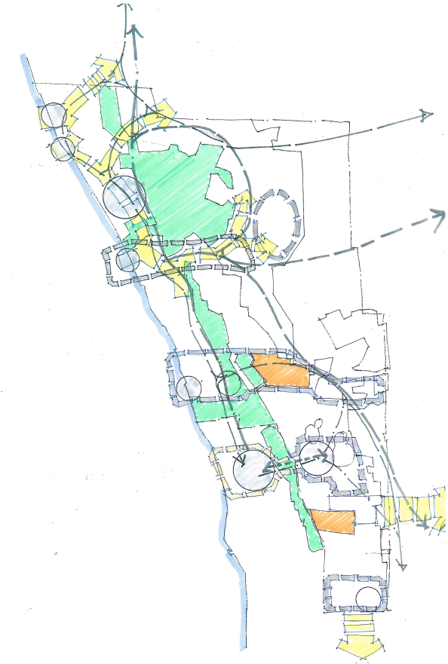
Wanneroo City -Transects for Liveability, Sense of Place & Emerging Enterprise Zones
Two Rocks – Yanchep City Transect
Land bank for strategic regional or state-wide infrastructure & facilities
Yanchep National Park – Jewel of the north
Eglinton – Yanchep – Carabooda Transect
‘Food Security’ agri-business hub
Coastal Living
Spearwood Dunes Urban Landscapes
Neerabup Industrial zone – potential ‘new economy enterprise zone’
Mindarie – Neerabup – South Pinjar Transect
Regional park & natural bushland reserve
The confluence of two Cities for mutual gain and advantage
‘Joondalup – Wanneroo Cities’ Transect
‘Old Wanneroo’ – revitalised to benefit from ethnicity mix and cultural diversity
And connect to adjacent communities
Girrawheen – Koondoola to Hillarys Transects

Slide 17
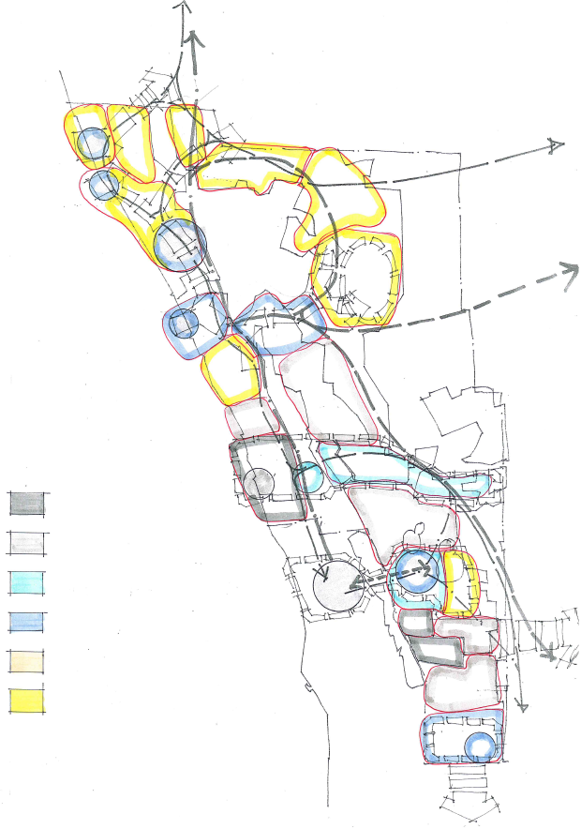
Opportunities for Retaining or Developing ‘Sense of Place’ (by major precinct)
Plenty of scope for making changes and developing distinctive ‘place’
Legend: The Three ‘R’s…
Retain (status quo)
1. Retain
Protect, Conserve
Refurbish, Modify
2. Refurbish
Enhance, Revitalise
Replace, Remove
3. Replace
Transform, Redevelop
NOTE: Assumes existing land use/development allows flexibility to change

Slide 18
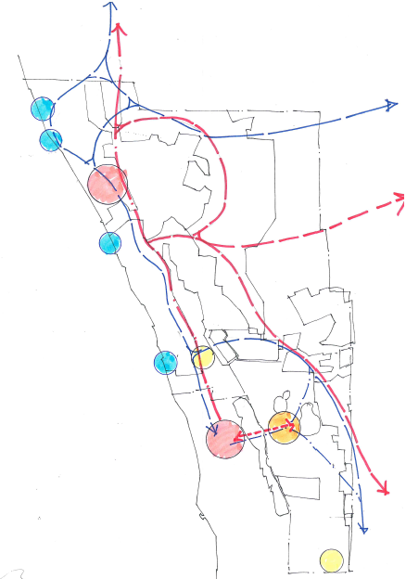
Road and rail connect to the north
Future Infrastructure Opportunities
Possible future port
Offshore commercial aquaculture and research hub
Rail to the Western Wheatbelt
Yanchep National Park
Future International Airport
Yanchep City
Very-fast Ferry transport connections
via expanded coastal hubs
Road freight routes to the ‘interior’
Conservation estate
Offshore ‘Oceania’ resort, commercial, residential hub
Wanneroo City overlooking Lake Jandabup
Joondalup City overlooking Lake Joondalup
Wanneroo City
Whiteman to Yanchep Highway
Joondalup City
Proposed Rail

Slide 19
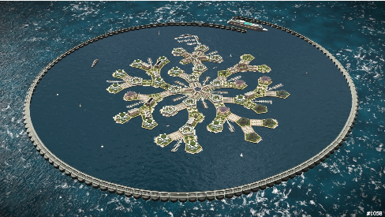
The SEASTEADING INSTITUTE
Artisanopolis – 1st Place Entry Architectural Design Contest
Offshore floating settlements, facilities and infrastructure are being designed & constructed....particularly in response to sea level rise risks for ocean island nations

Slide 20
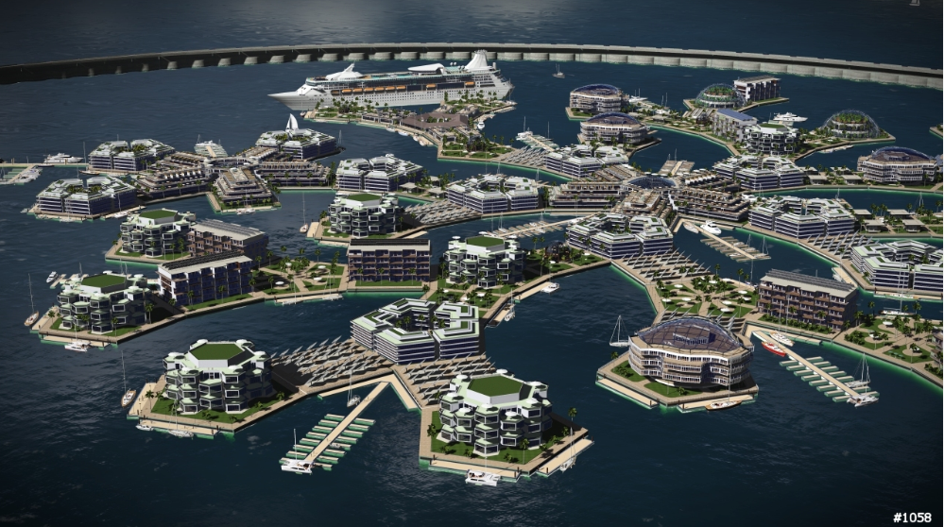

Slide 21
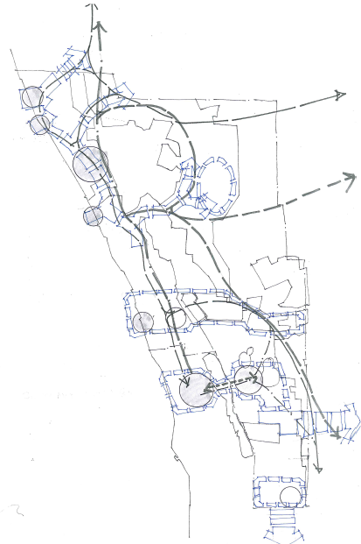
Long Term Opportunities:
Aerotropolis (second International Airport)
Yanchep ‘Gateway’ City New Enterprise Zone
Regional Linkages to the east and north
Food Security Precinct – horticulture, market gardening
Joondalup-Wanneroo Twin Cities Enterprise Zone

Slide 22
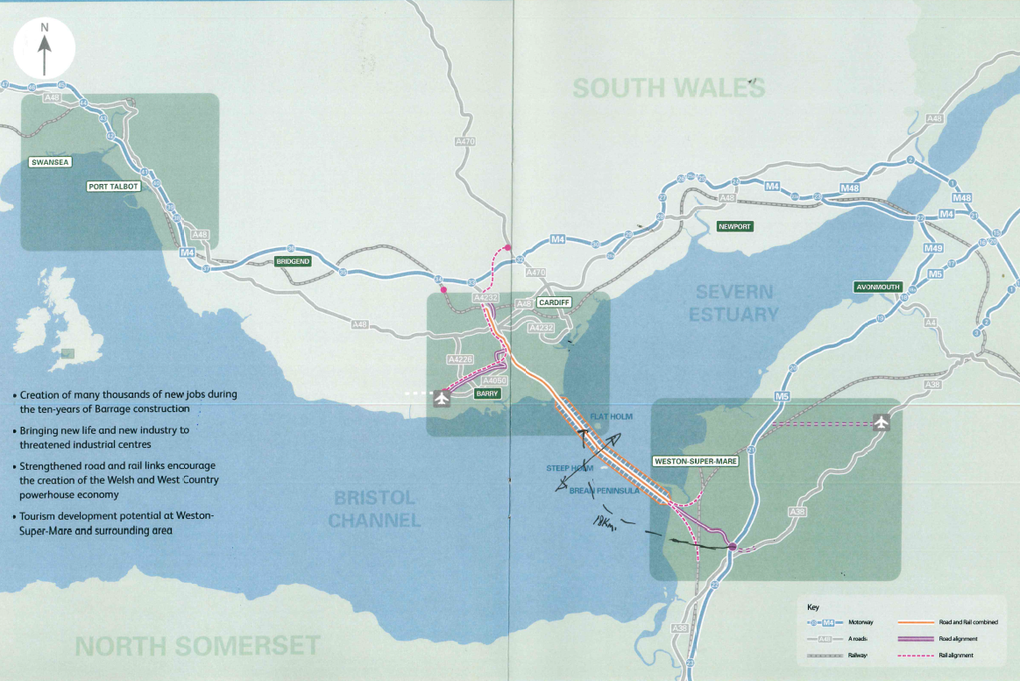
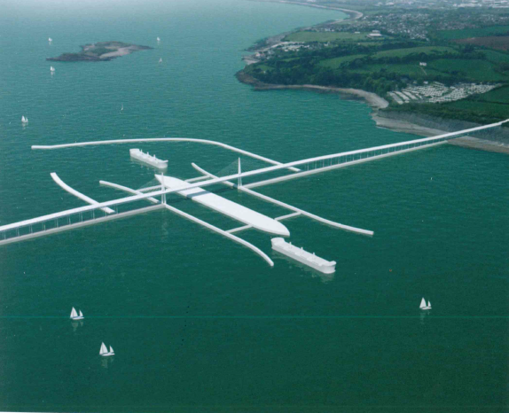
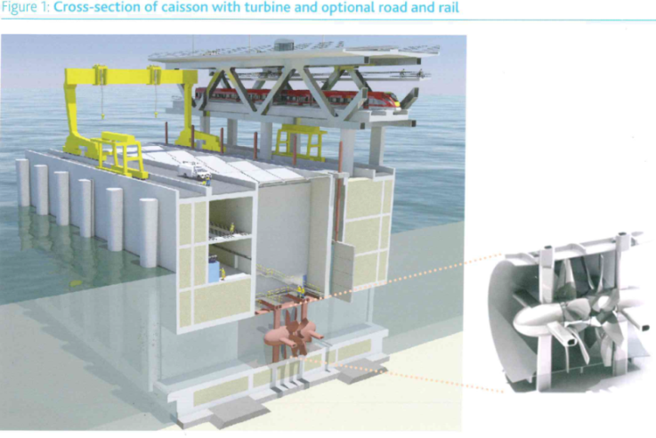
The Severn Barrage Project case study* – Privately financed with $100 Bn Sovereign Wealth Funds (63 tidal energy power turbines - each 13 metres in height)
Key Facts:
5% of UK power needs for + 120 years & near 100% reliability
- Zero CO2 emissions
- 75% cheaper than fossil fuels
- Equivalent power output to 4 nuclear power stations
Create new ports, rail and motorway infrastructure connectivity
Create 50,000 jobs in first 9 years (& then the multiplier to kick in)
Completely transform regional economies of S Wales & S West
Rolls Royce to build new factory for bespoke turbines
[*Just in case you’re losing your nerve!]

Slide 23
About Infrastructure Investment Funds….
Don’t answer the phone for less than $100m
Packages for $200-500m are normal
US$1bn + common….
US$100bn not unheard of….
Favour low risk – but reliable returns
Often draw upon Sovereign Wealth Funds
total US$20 trillion world-wide
Looking globally for projects to invest in
We shouldn’t be afraid to Think Big……

Slide 24
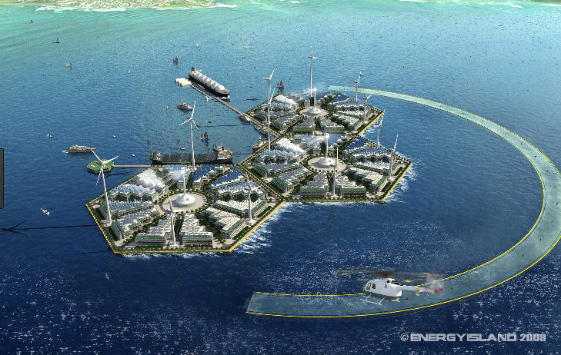
Thank you

