Slide 1
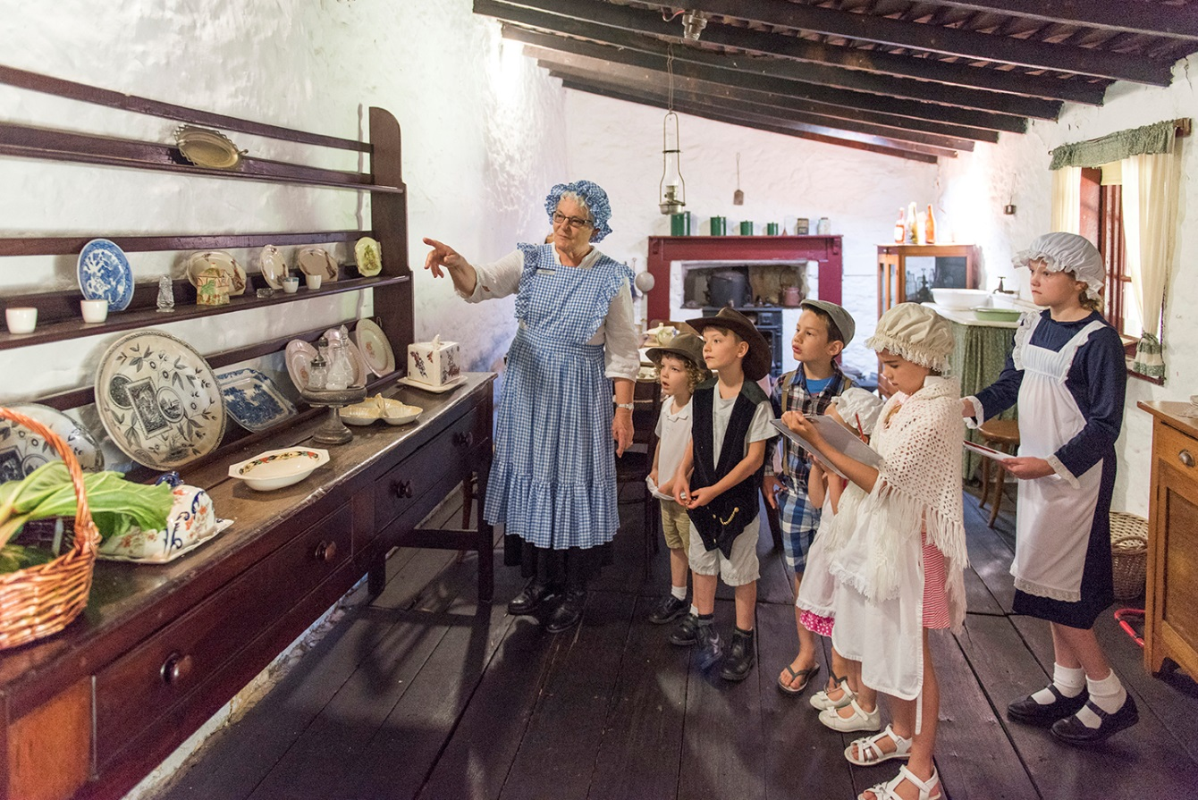
Historical Object Investigation
Comparing Past and Present Objects
Notes:
Please see the Comparing past and present objects in the home resource which support this PowerPoint and provide additional activities and resources.
Available from: https://www.wanneroo.wa.gov.au/downloads/download/200/wanneroo_regional_museum_education_resources

Slide 2
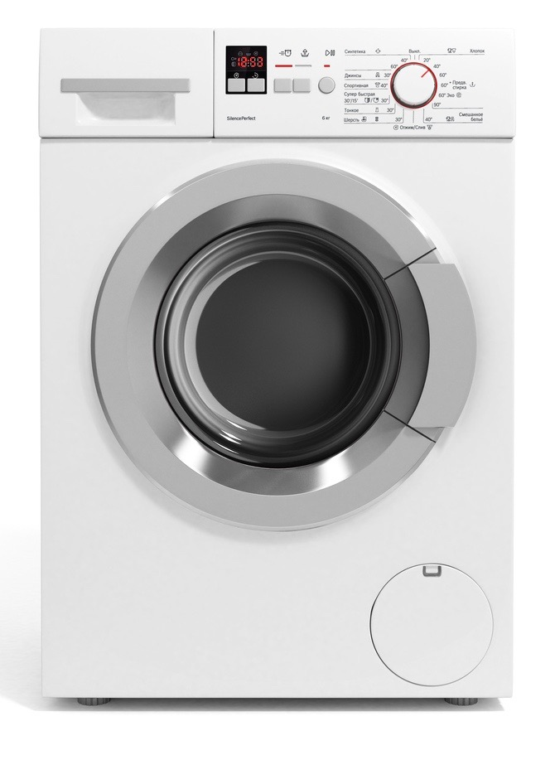
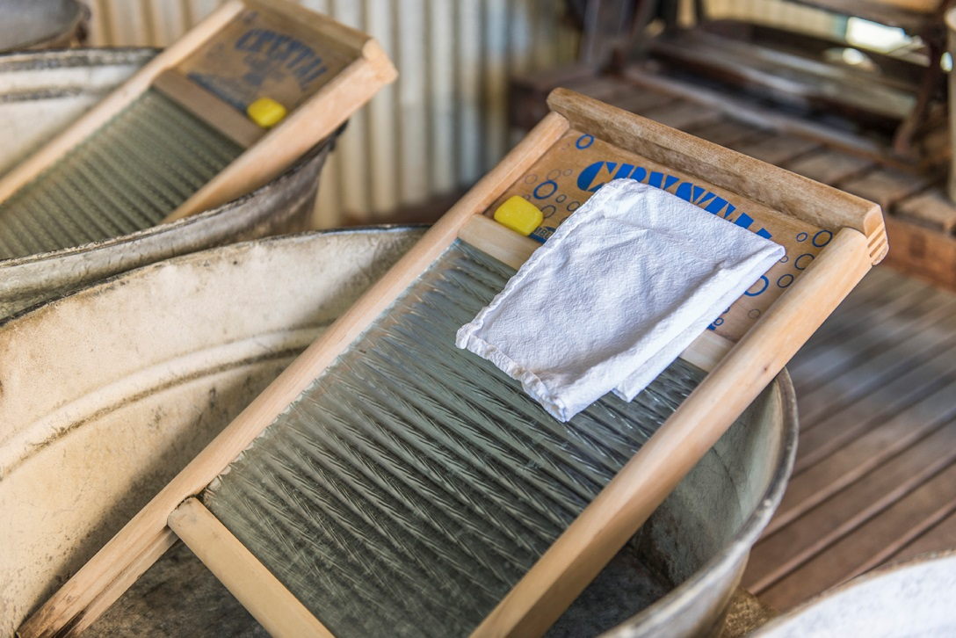
Compare…

Slide 3
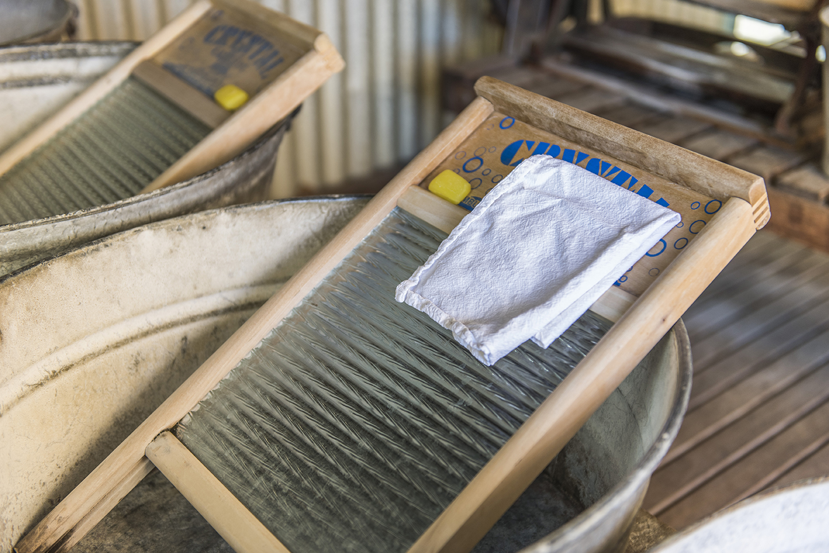

Slide 4
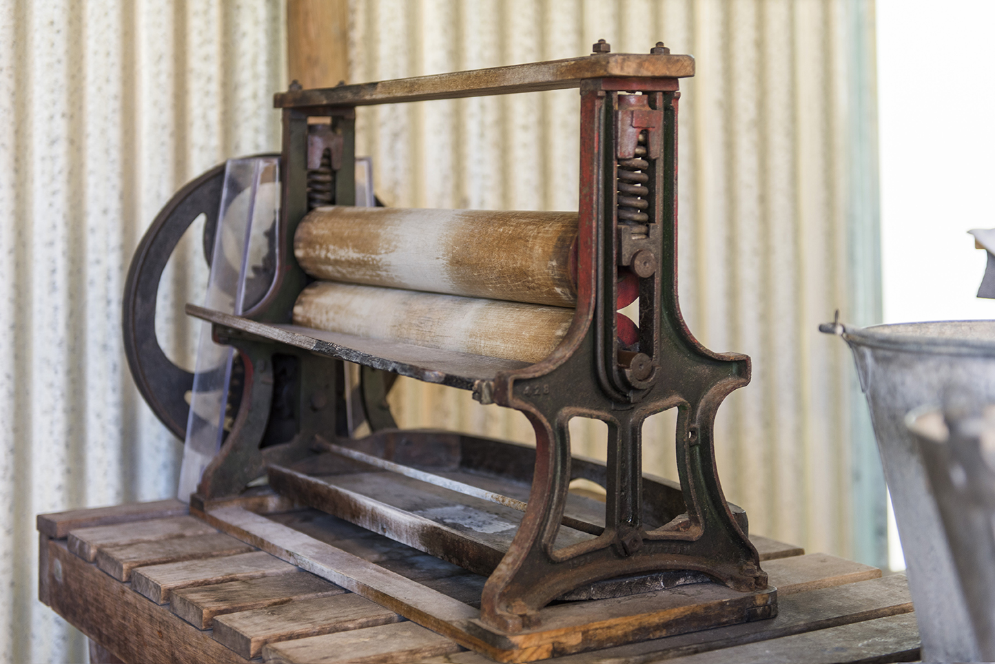
Notes:
A mangle – for squeezing out the water from clothes.

Slide 6
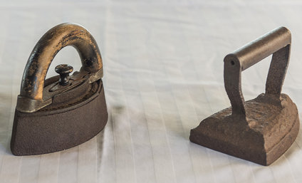
Notes:
Mrs Potts’iron (left) and a flat iron.

Slide 7
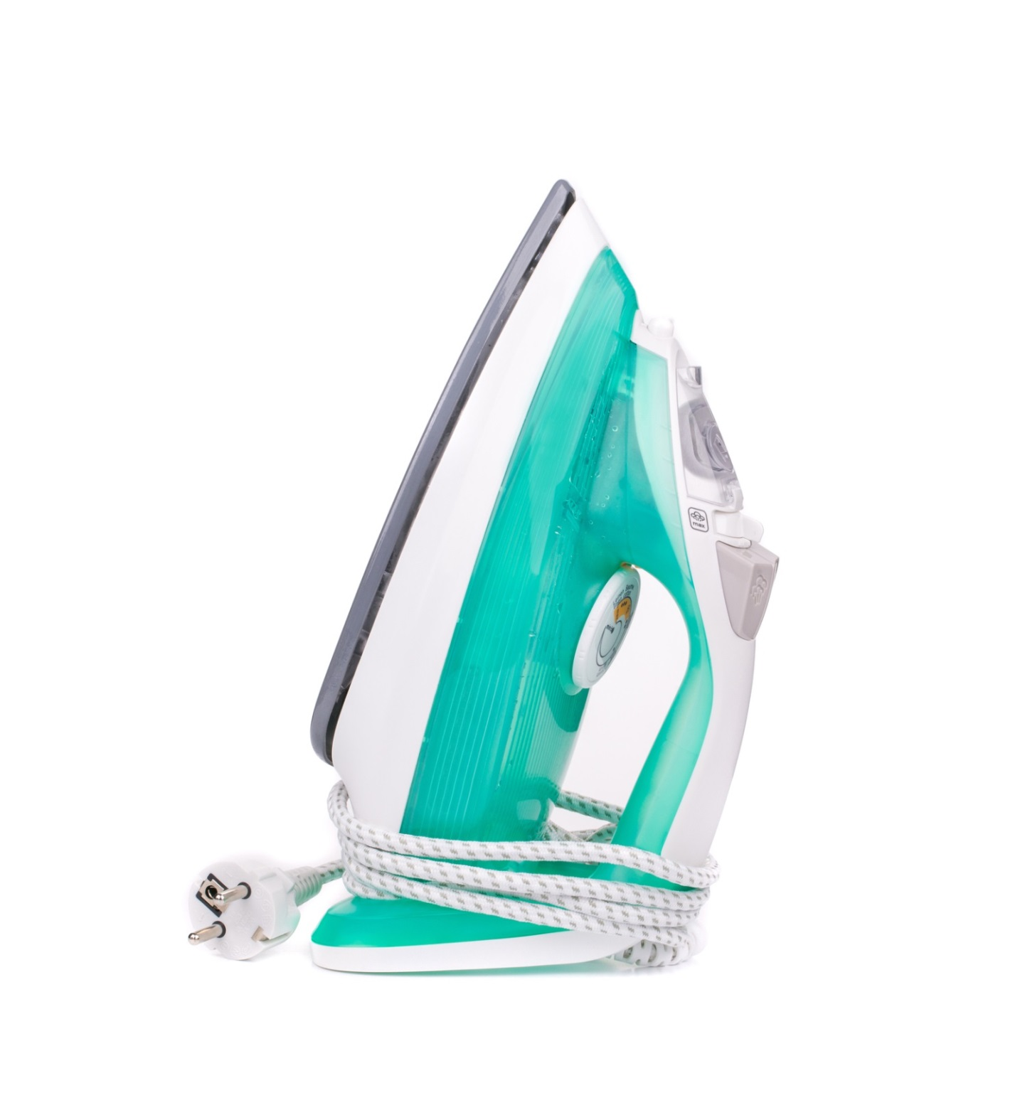

Slide 8
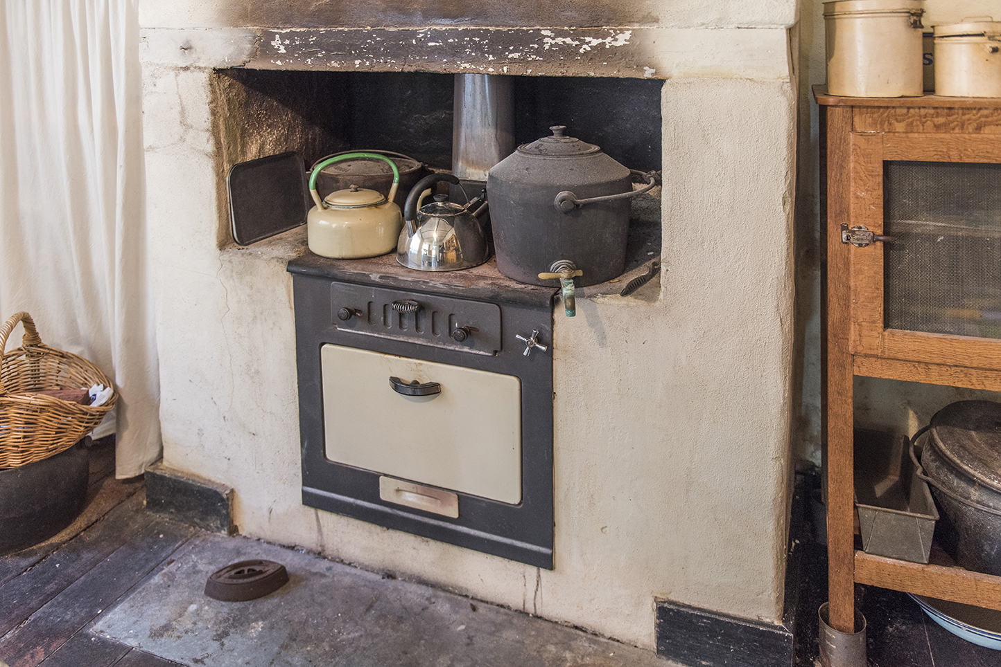
Notes:
Wood stove oven

Slide 9
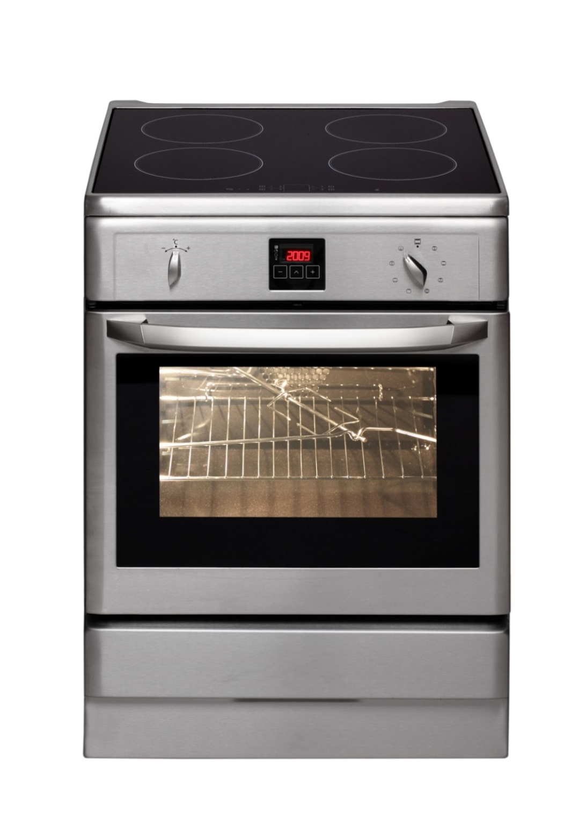

Slide 10
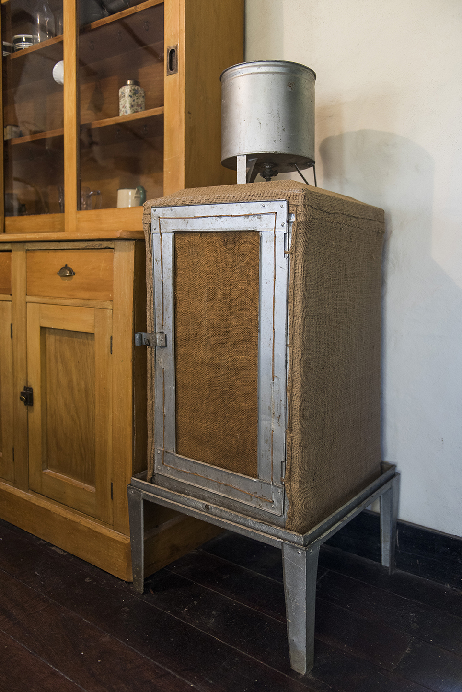
Notes:
Coolgardie safe

Slide 11
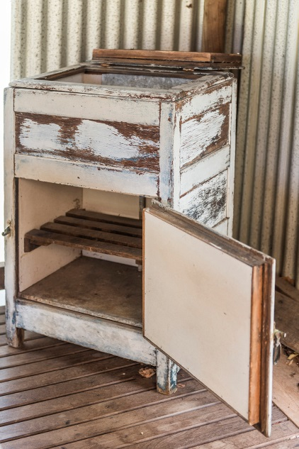
Notes:
Ice chest

Slide 12
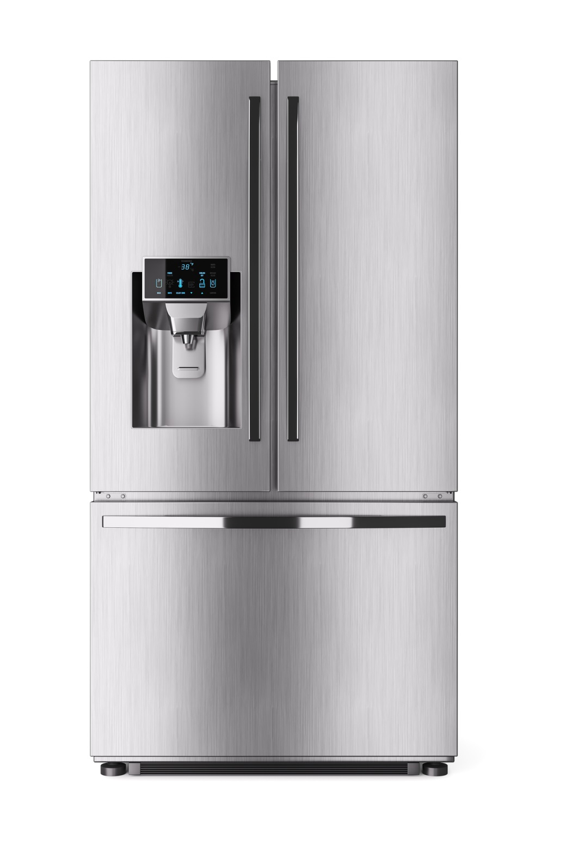

Slide 13
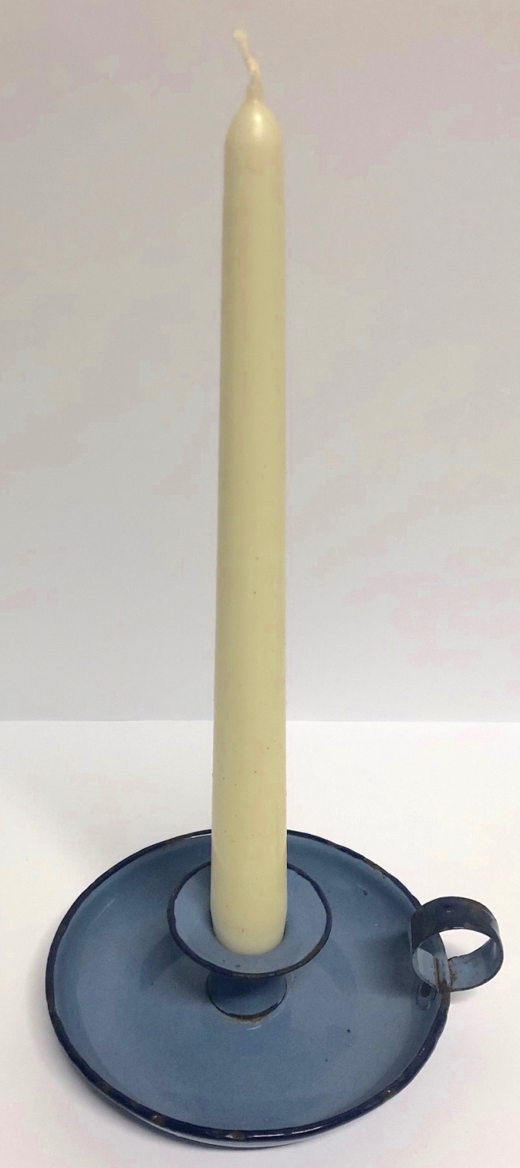

Slide 14
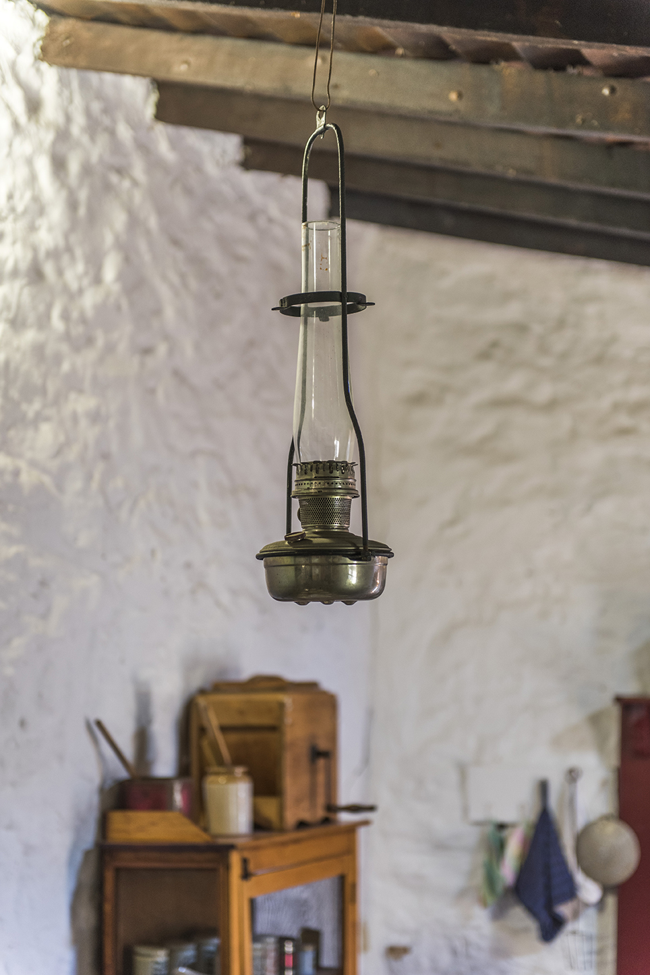
Notes:
Oil lamp

Slide 15
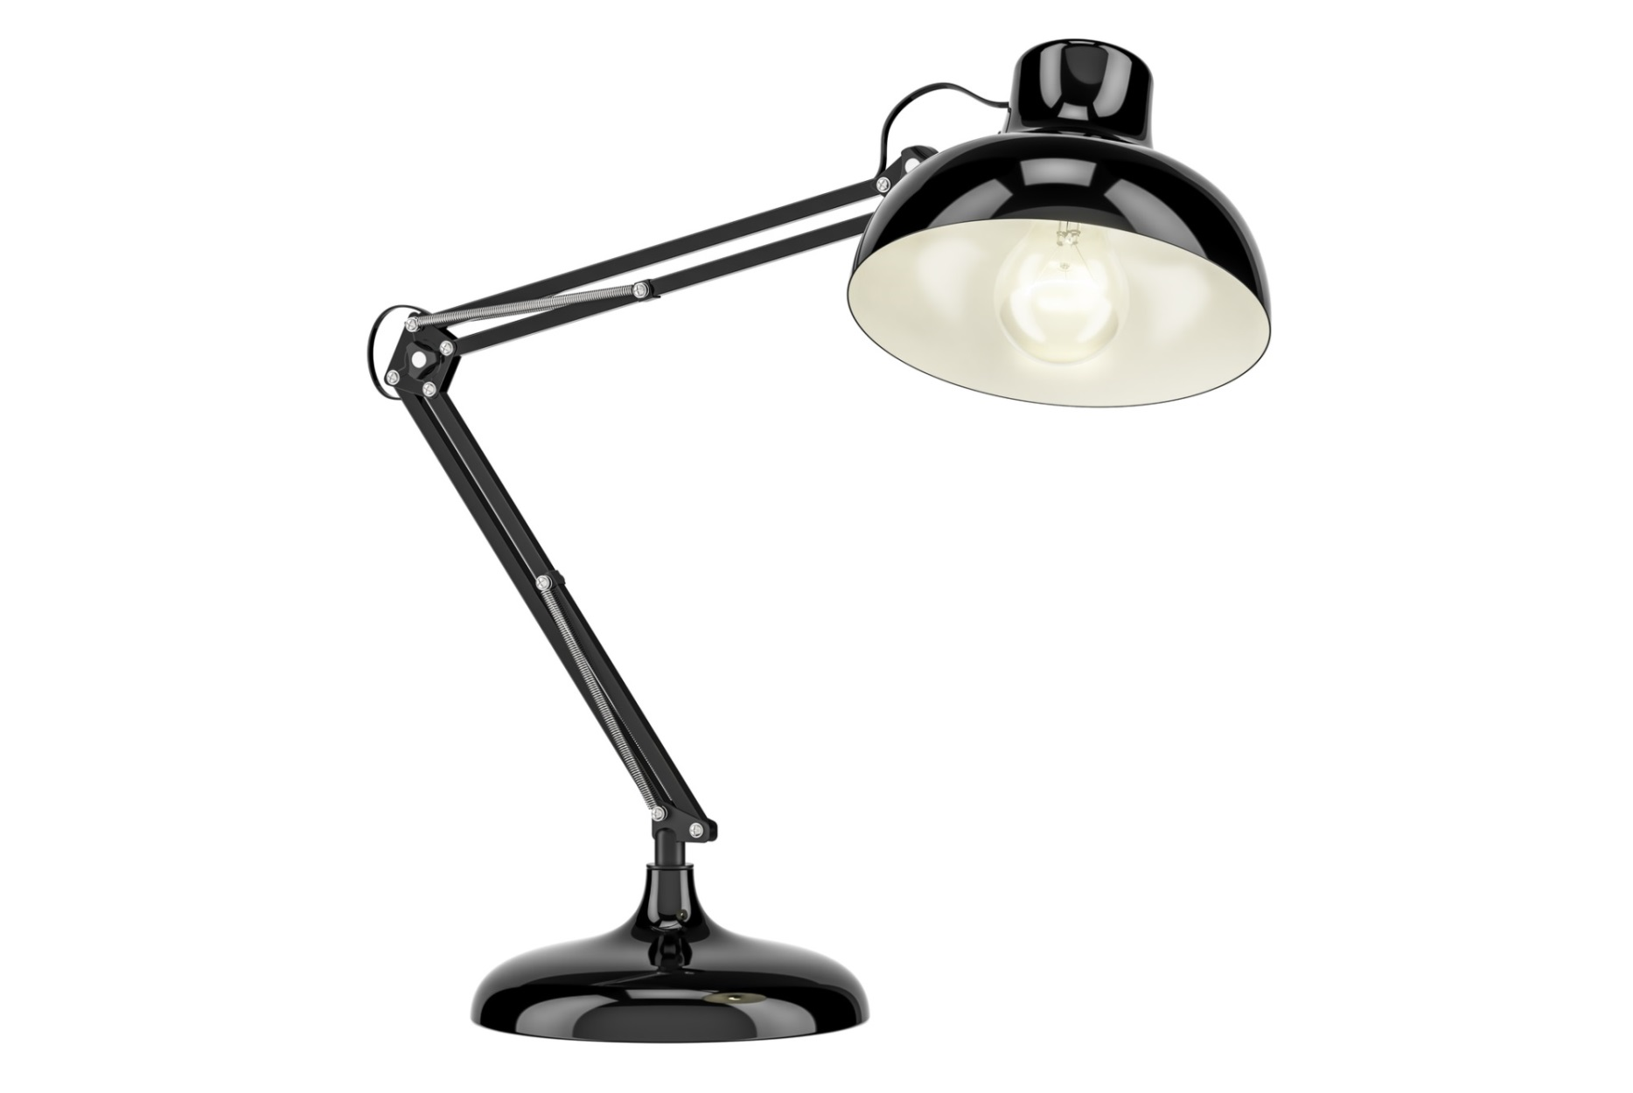

Slide 16
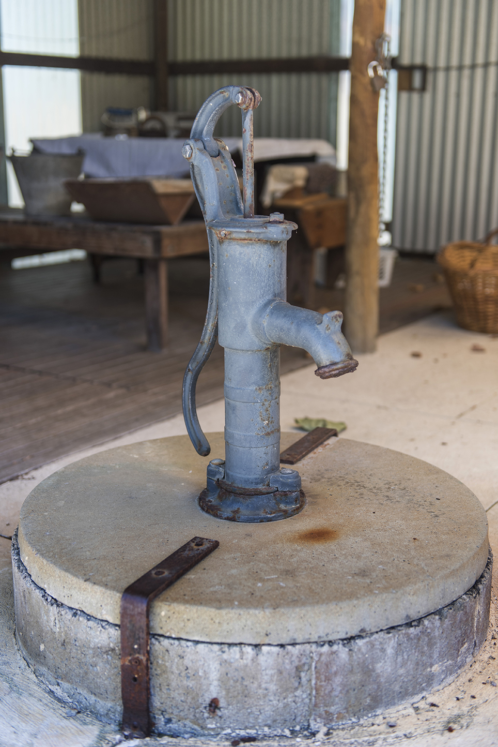
Notes:
Water pump (Buckingham House)

Slide 17
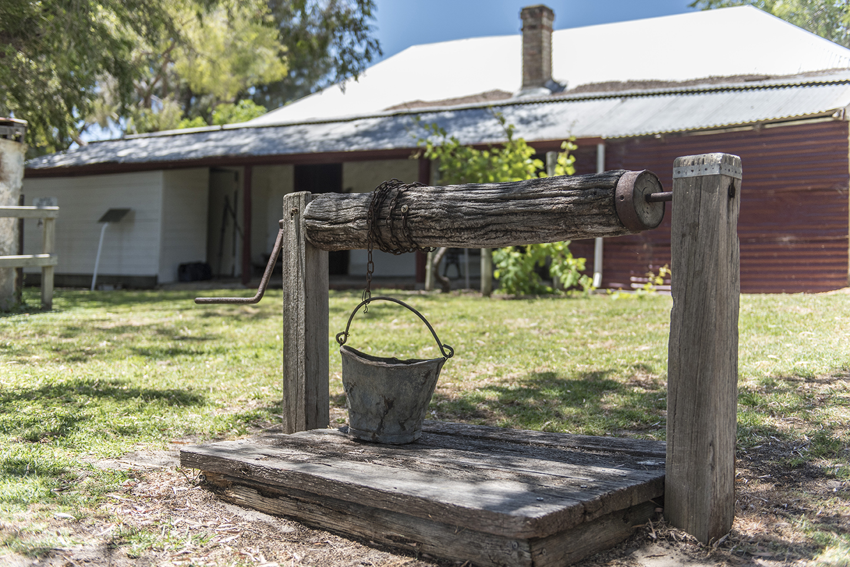
Notes:
Well (Cockman House)

Slide 18
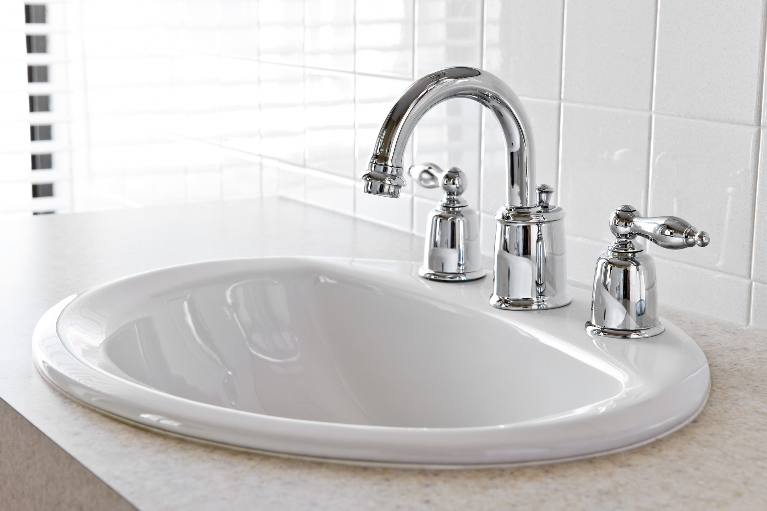

Slide 19
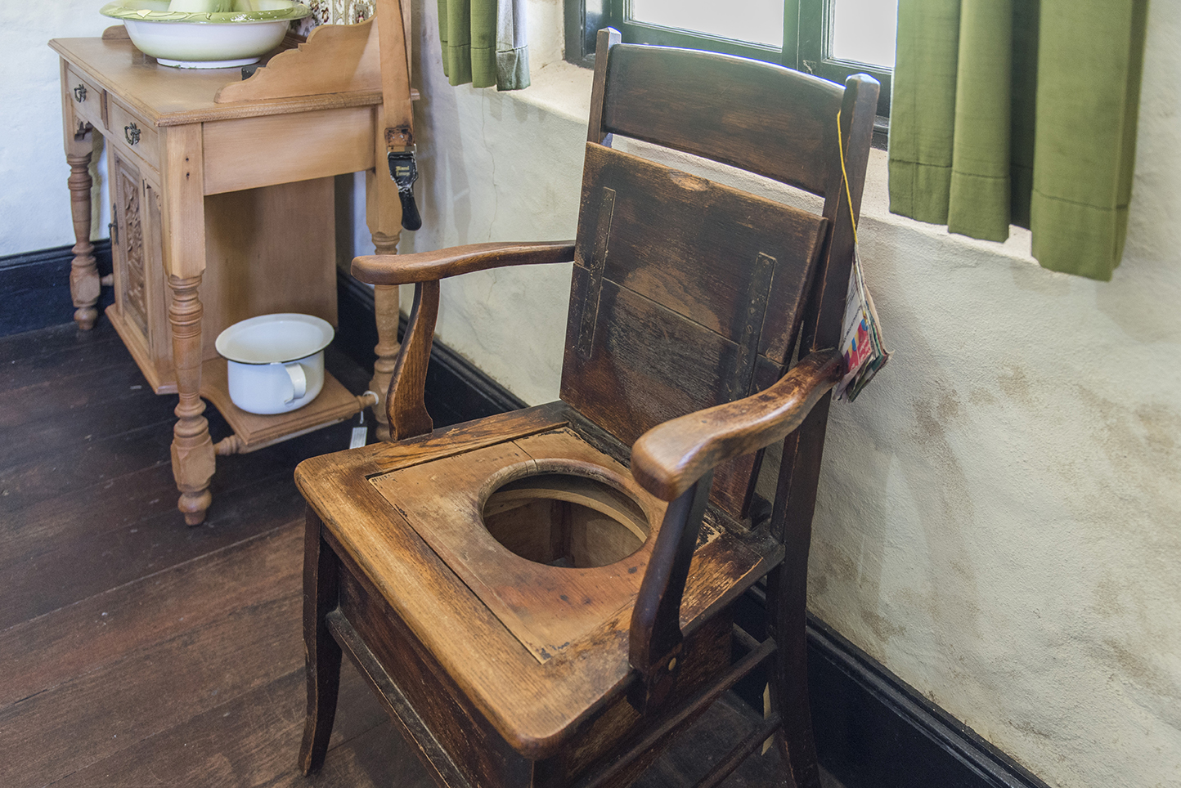
Notes:
Toilet commode

Slide 20
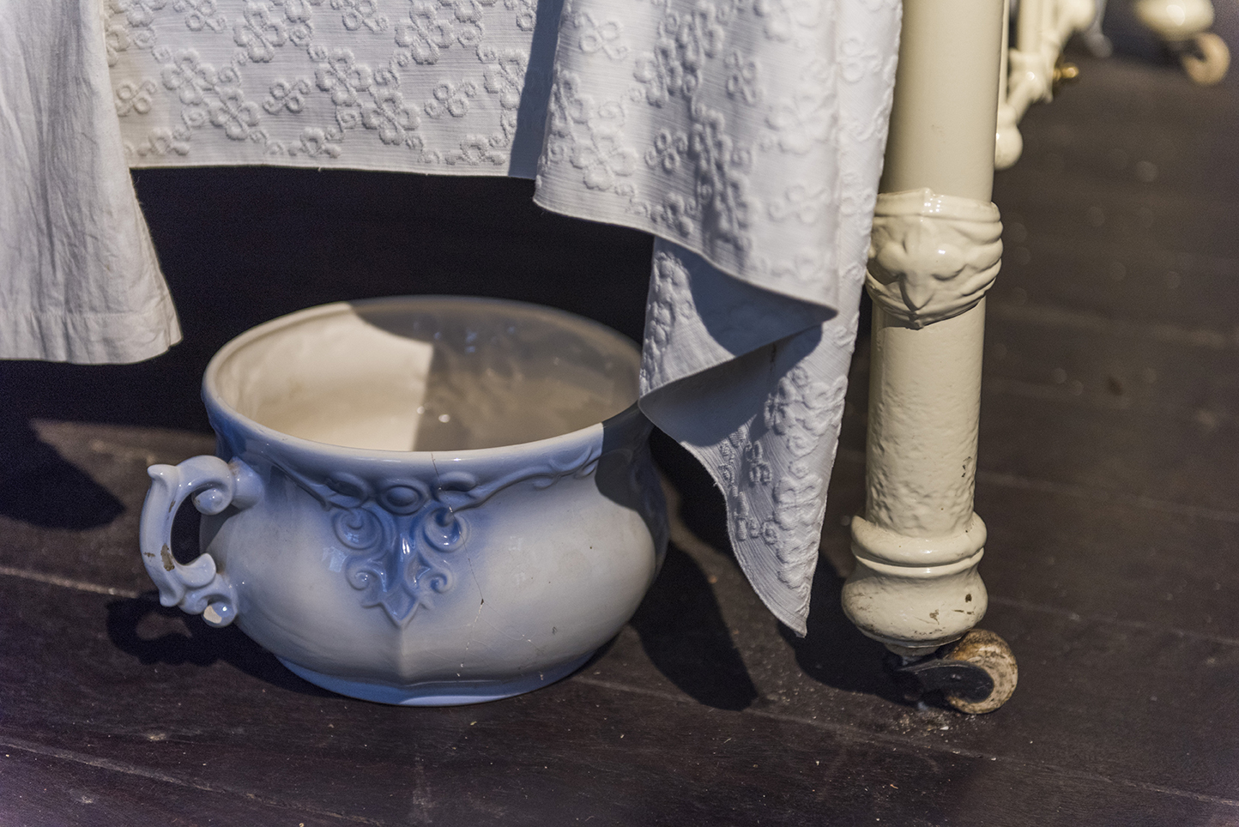
Notes:
Chamber pot or potty

Slide 21
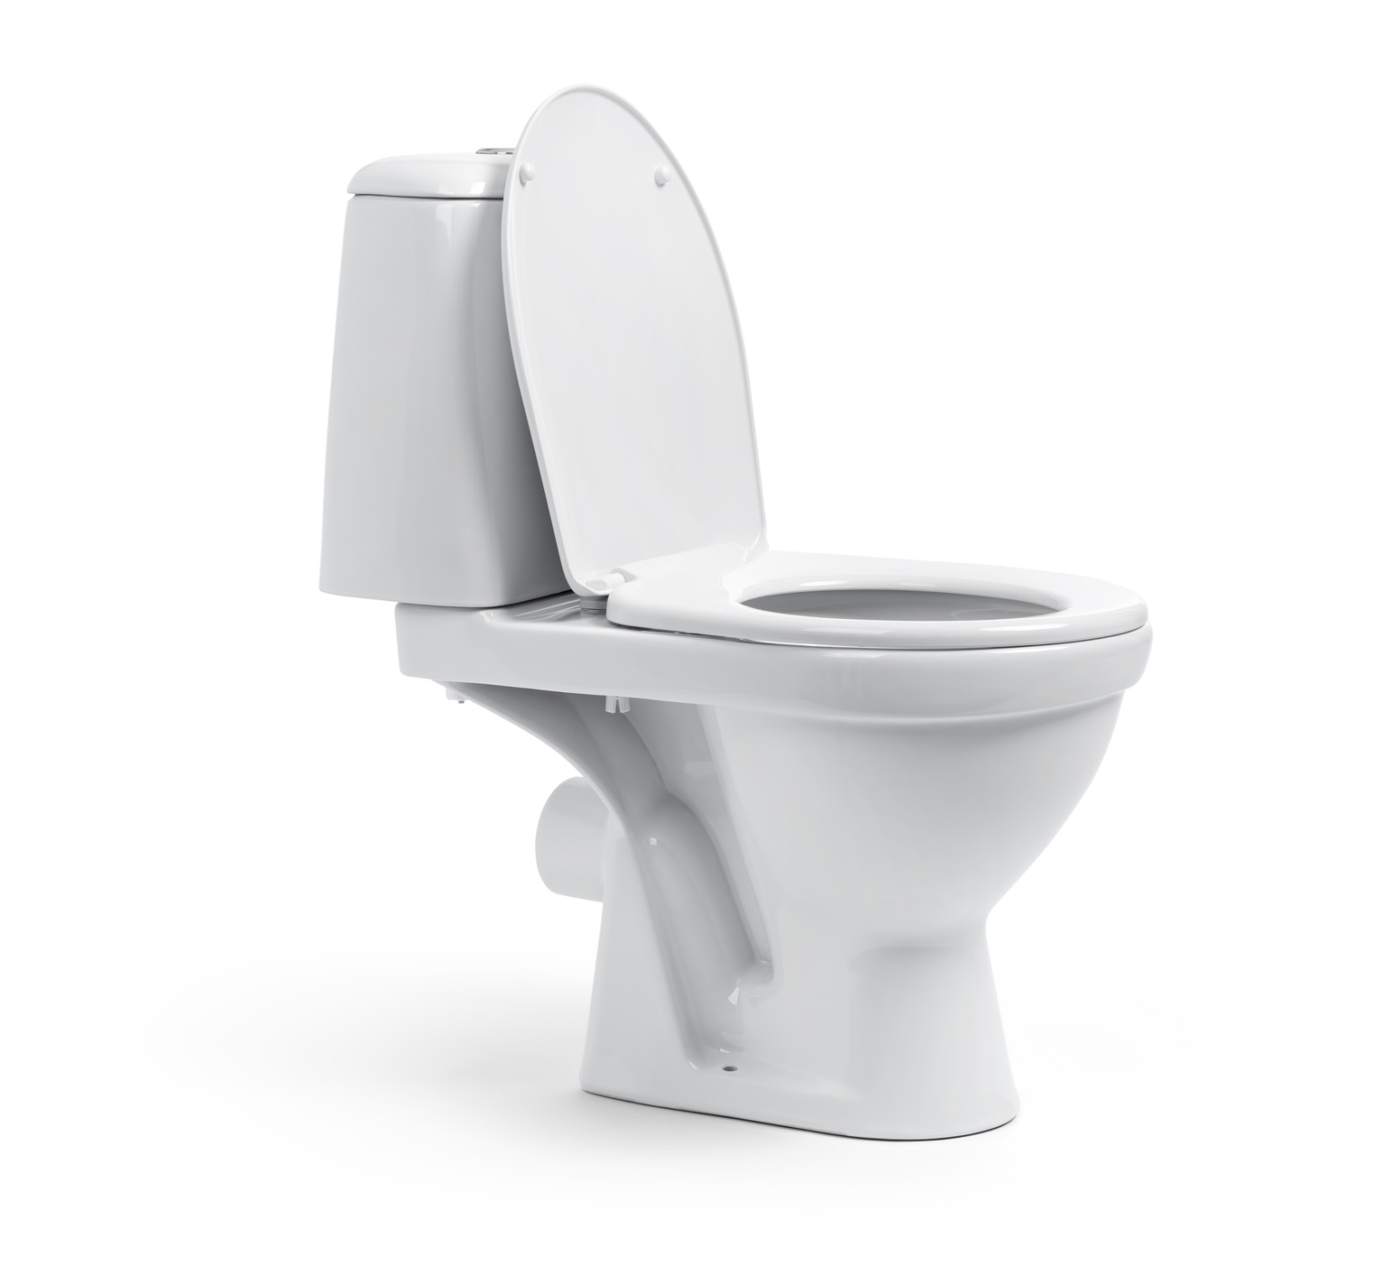

Slide 22
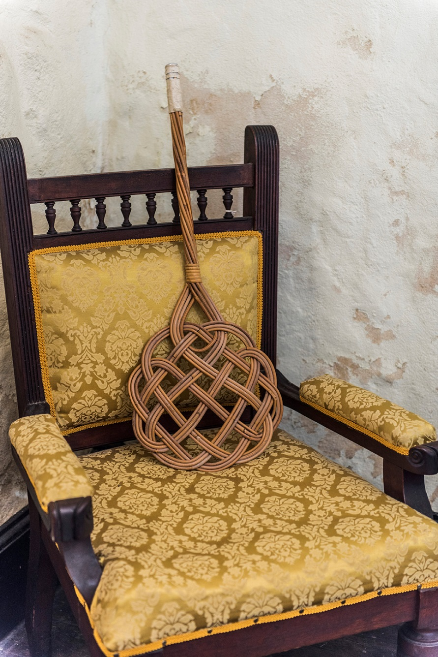
Notes:
A rug beater

Slide 23
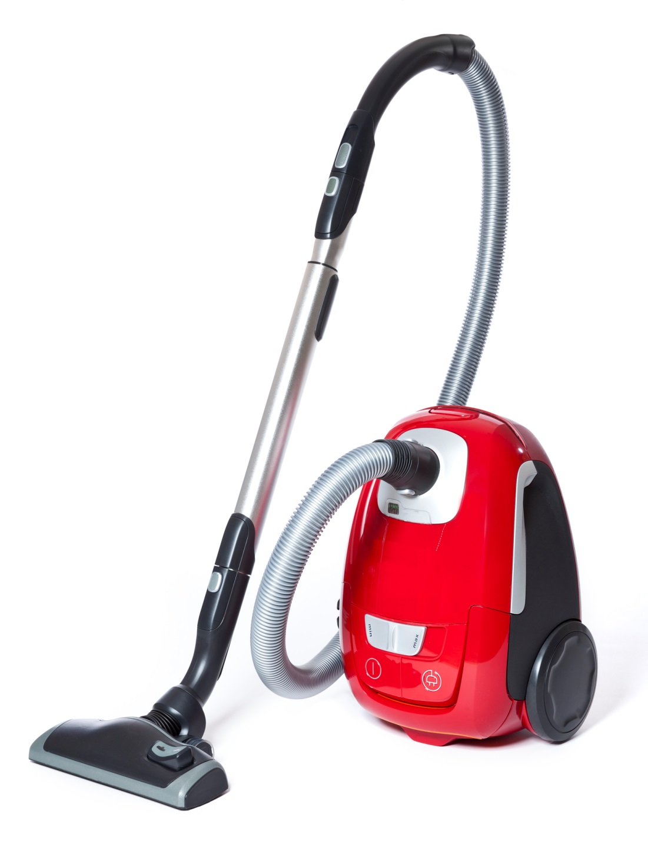

Slide 24
The boys chopped and gathered wood for the fire and helped dad in the garden, while the girls helped mum in the house and kitchen.
Margaret Cockman
My girls could cook, wash clothes and do everything in and around the house by the time they were 14.
Eva Mola
Talking about washing day
…The sheets were the worst to wring and hang out. We girls helped with the sheets and towels. We ironed all the clothes over a towel using an iron heated on the woodstove.
Zivkovich family
Notes:
Chores and children’s work as recalled by early Wanneroo residents.
Quotes taken from:
Marwick, B.; The Wanneroo and Districts Historical Society. (2005). The times of Wanneroo: as told to Bill Marwick. Wanneroo and Districts Historical Society.
Leigh, C.; Wanneroo Regional Museum. (2016). Live, work, play: Wanneroo recollections. Wanneroo Regional Museum.
Marwick, B.; City of Wanneroo. (2002) Stories of Old Wanneroo: As told to Bill Marwick. City of Wanneroo.

Slide 25
Some kids worked an hour or two in the gardens or dairies before school.
Steve and Nick Jambanis
Sam said that at 14 he was expected to do a man’s work, and he did. “I worked alongside adult workmen in the garden turning the swamp peat over with a spade”.
Sam Conti (1940s)

