Slide 1
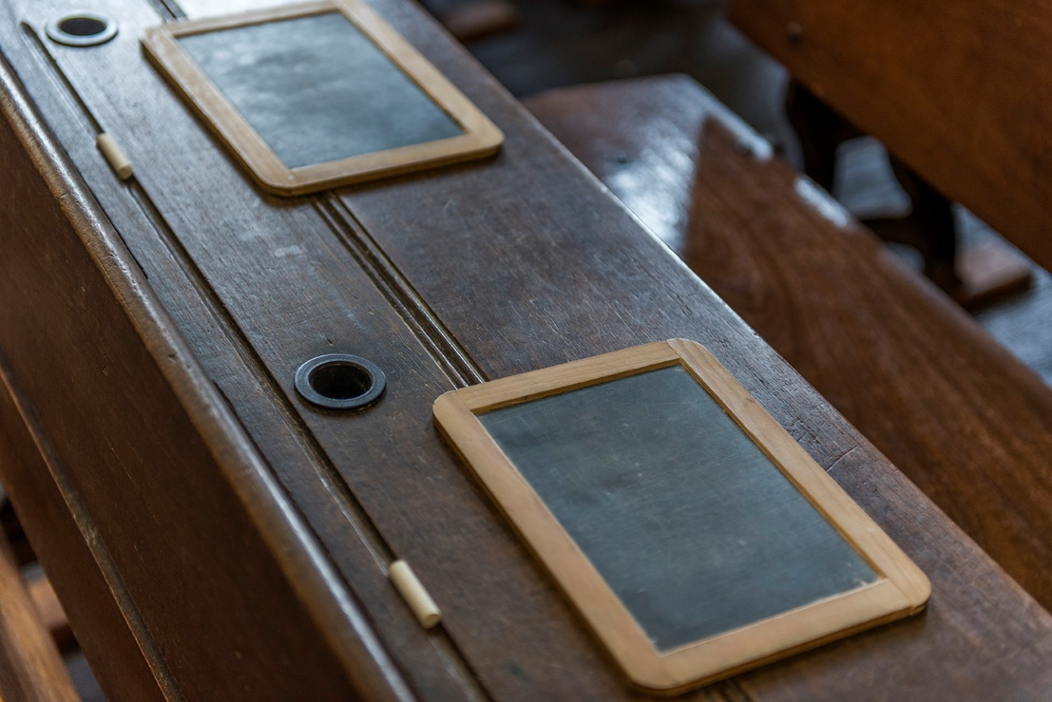
Old School Days in Wanneroo

Slide 2
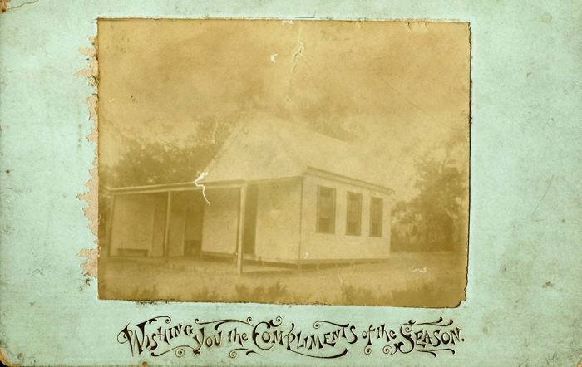
Wanneroo School building 1905
BRN: 242325

Slide 3
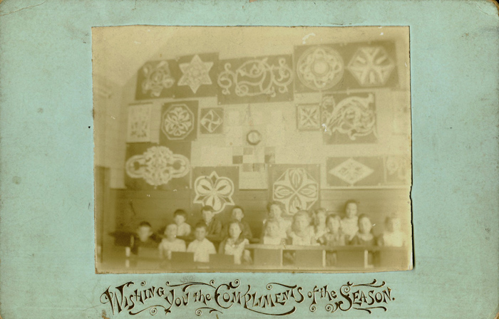
Pupils at Wanneroo School 1905
BRN: 242324

Slide 4
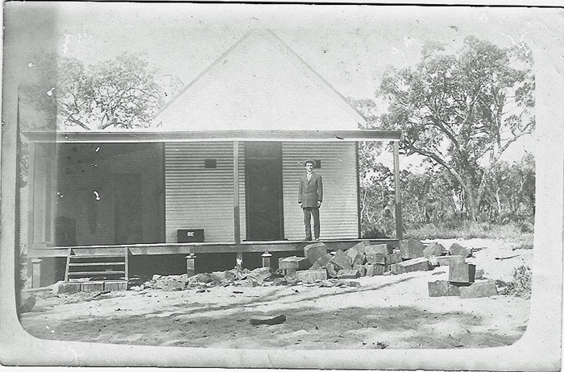
Fred White on the verandah of the Wanneroo schoolhouse 1910s
BRN: 287714
Notes:
See
What can you see in this photograph?
Describe the school building.
What can you see around the school?
Describe the person in the photograph.
Think
What materials were used to make this school?
Why does the school only have one building?
Who is the person in the photograph?
Why was the photograph taken?
When was the photograph taken?
Wonder
What does this photograph make you wonder?
What other questions would you like to find out?

Slide 5
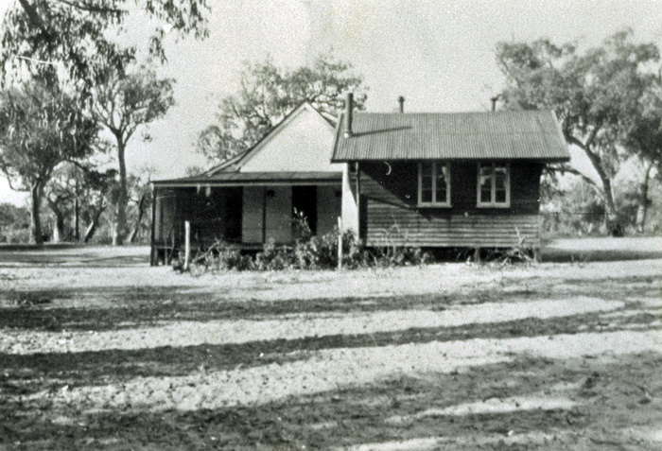
Wanneroo State School 1933
BRN: 300024

Slide 6
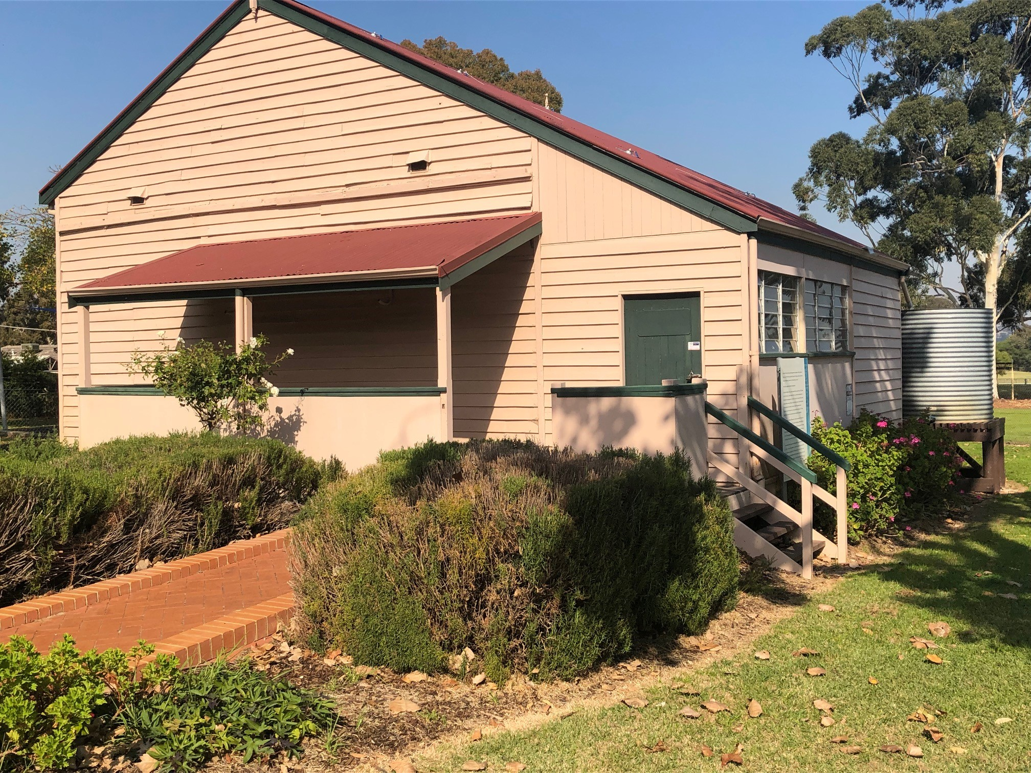
Old Wanneroo Schoolhouse 2022

Slide 7
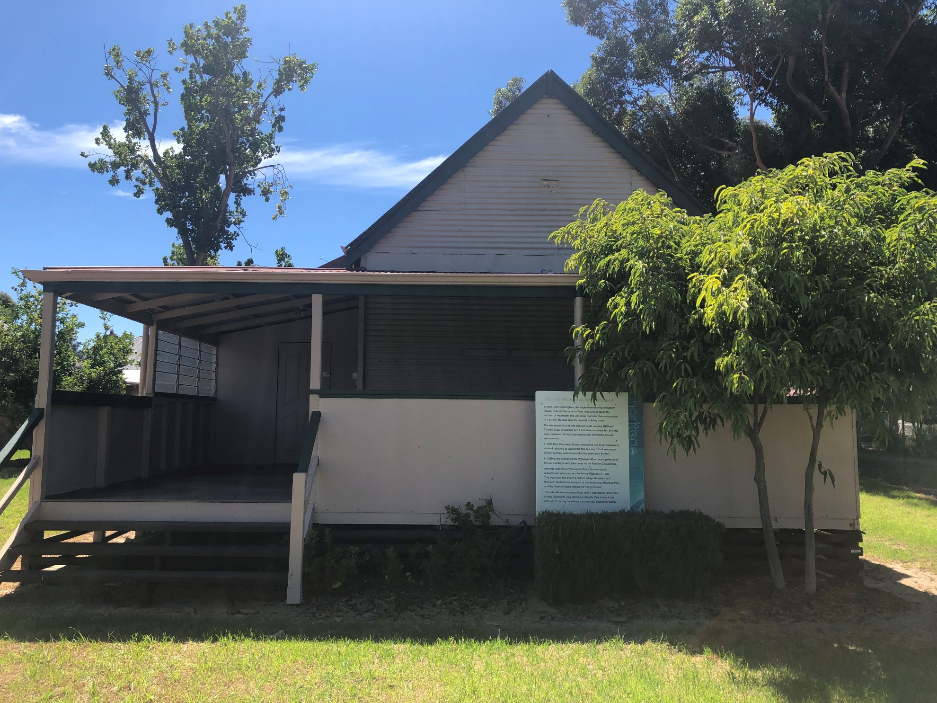
Old Wanneroo Schoolhouse 2022

Slide 8
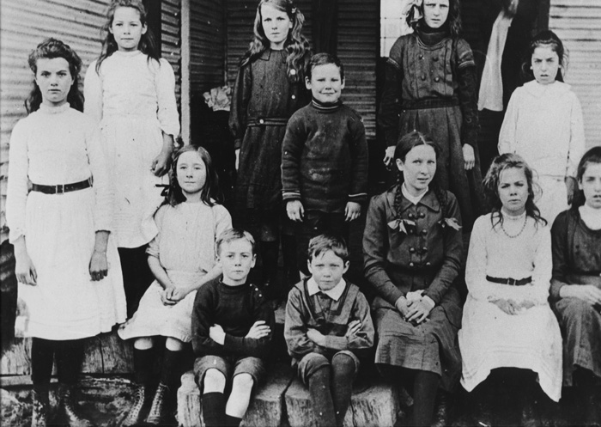
Wanneroo State School class of 1911
BRN: 396865
Notes:
See
Who is in the photograph?
What are the children wearing?
What are the children’s hairstyles?
What is the facial expression of the children?
How are the children posing in the photograph?
Think
What are the ages of the children?
Why was the photograph taken?
When was the photograph taken?
What is in the background of the photograph?
Wonder
What does this photograph make you wonder?
What other questions would you like to find out?

Slide 9
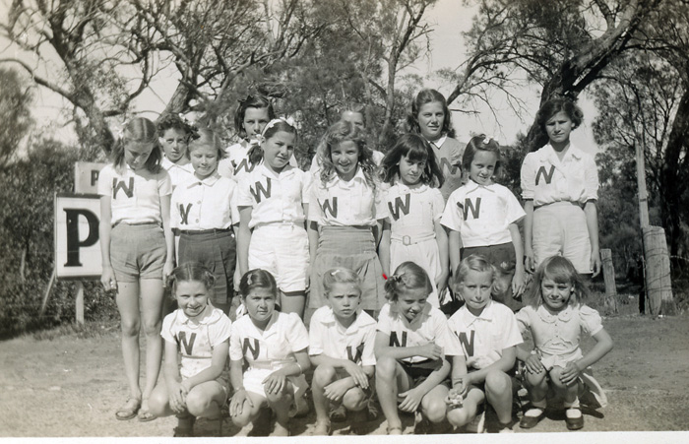
Wanneroo State School Athletic Carnival, outside Pearsall's Service Station 1947
BRN:493683

Slide 10
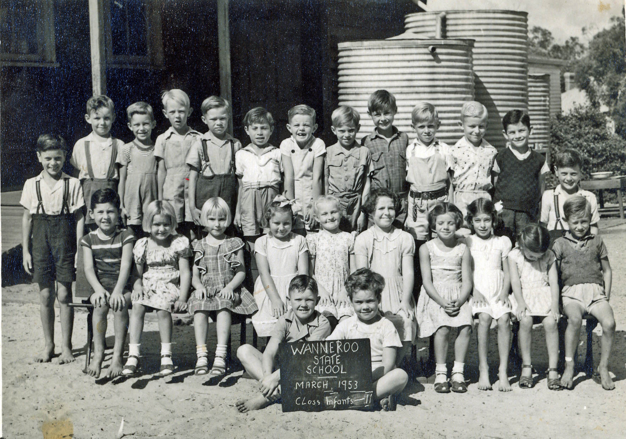
Wanneroo State School Class Infants to standard 2 1953
BRN: 491406

Slide 11
Travelling to School

Slide 12
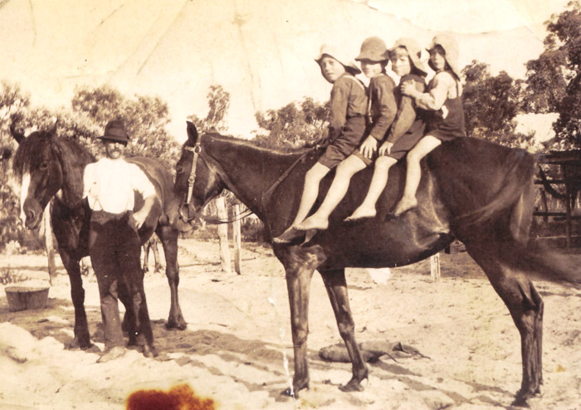
Charles Leach watches on as Charles (Charlie), Ronald, George Bernard (Bernie) and Lionel prepare to leave for school on horseback. 1920s
BRN: 251998

Slide 13
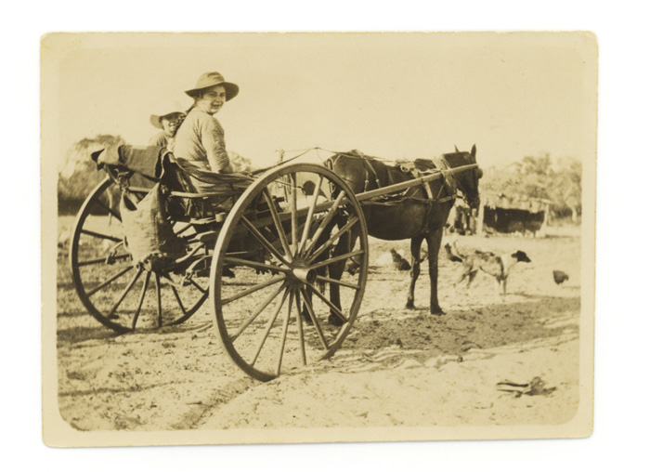
Gertrude (Gertie) Caporn takes her sister, Alma, in the horse and cart to her first day at school in East Wanneroo in 1924
BRN: 251927

Slide 14
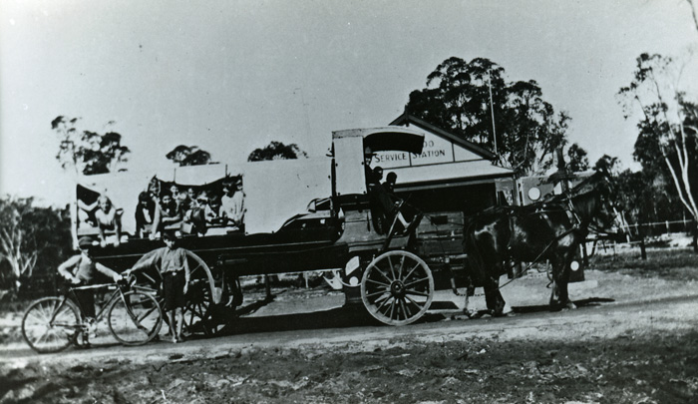
Charabanc school bus 1920s
BRN: 263359

Slide 15
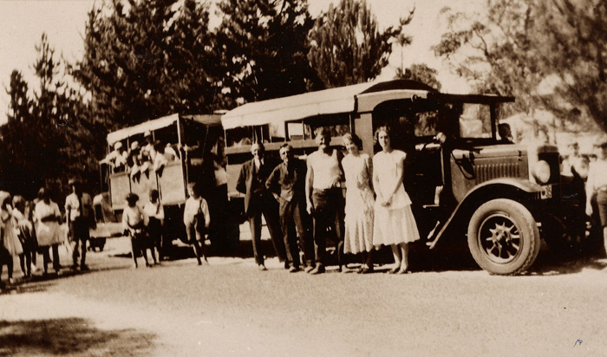
Travelling to school in 1933
BRN: 251928

Slide 16
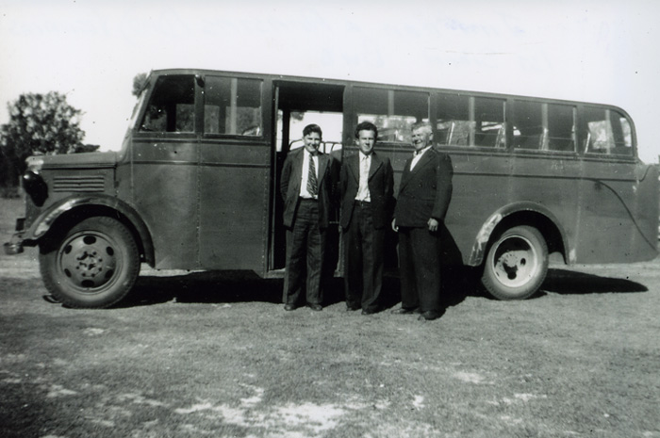
James, Constantine and Anastas Vosnacos with the first Bedford school bus 1949
BRN: 286638

Slide 17
School Lessons

Slide 18
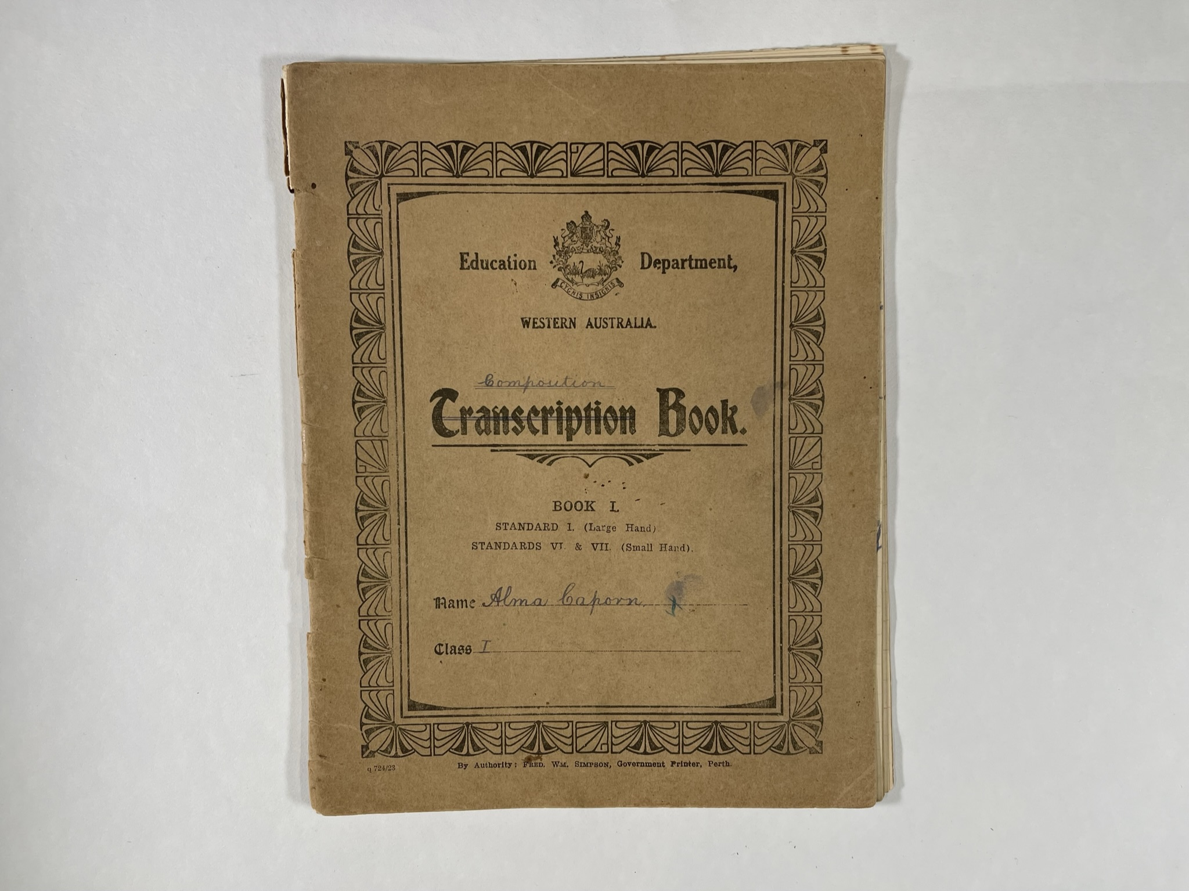
Notes:
Alma Caporn’s Composition book. (1920s) Alma was 8 years old at this time. Composition writing is creative writing tasks.
These examples show what cursive writing looks like. Cursive writing was taught after students could print the individual letters. Cursive was faster and neater. Because the writer did not need to lift the pen as often, there would be less splotches with ink. Blotting paper is absorbent paper which was placed on top of the writing to remove excess ink. This way the writer did not have to wait for the ink to dry before turning the page.

Slide 19
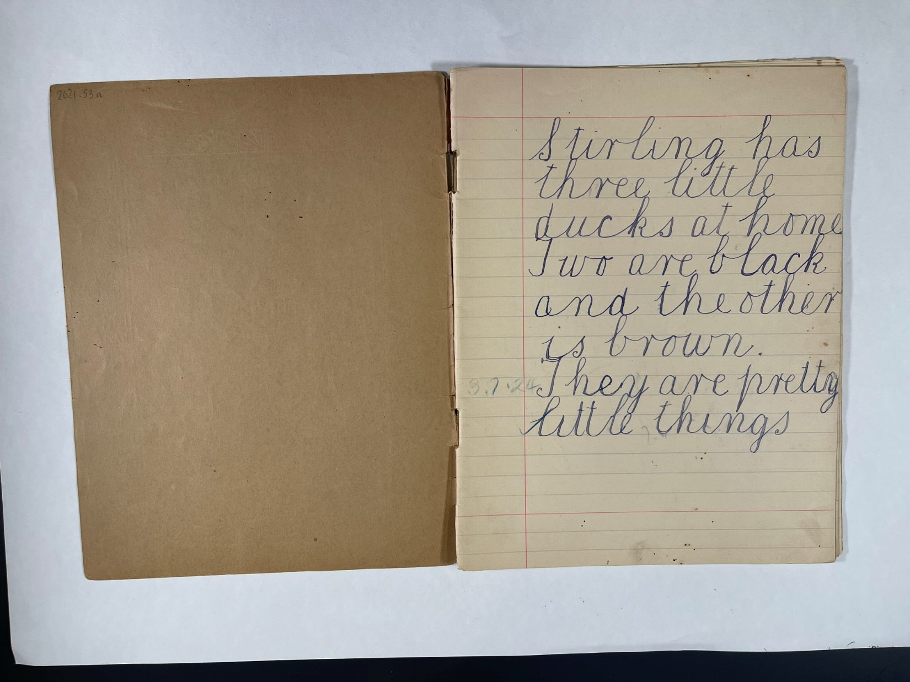
Notes:
Stirling has three little ducks at home. Two are black and the other is brown. They are pretty little things. ( Stirling is Alma’s brother)

Slide 20
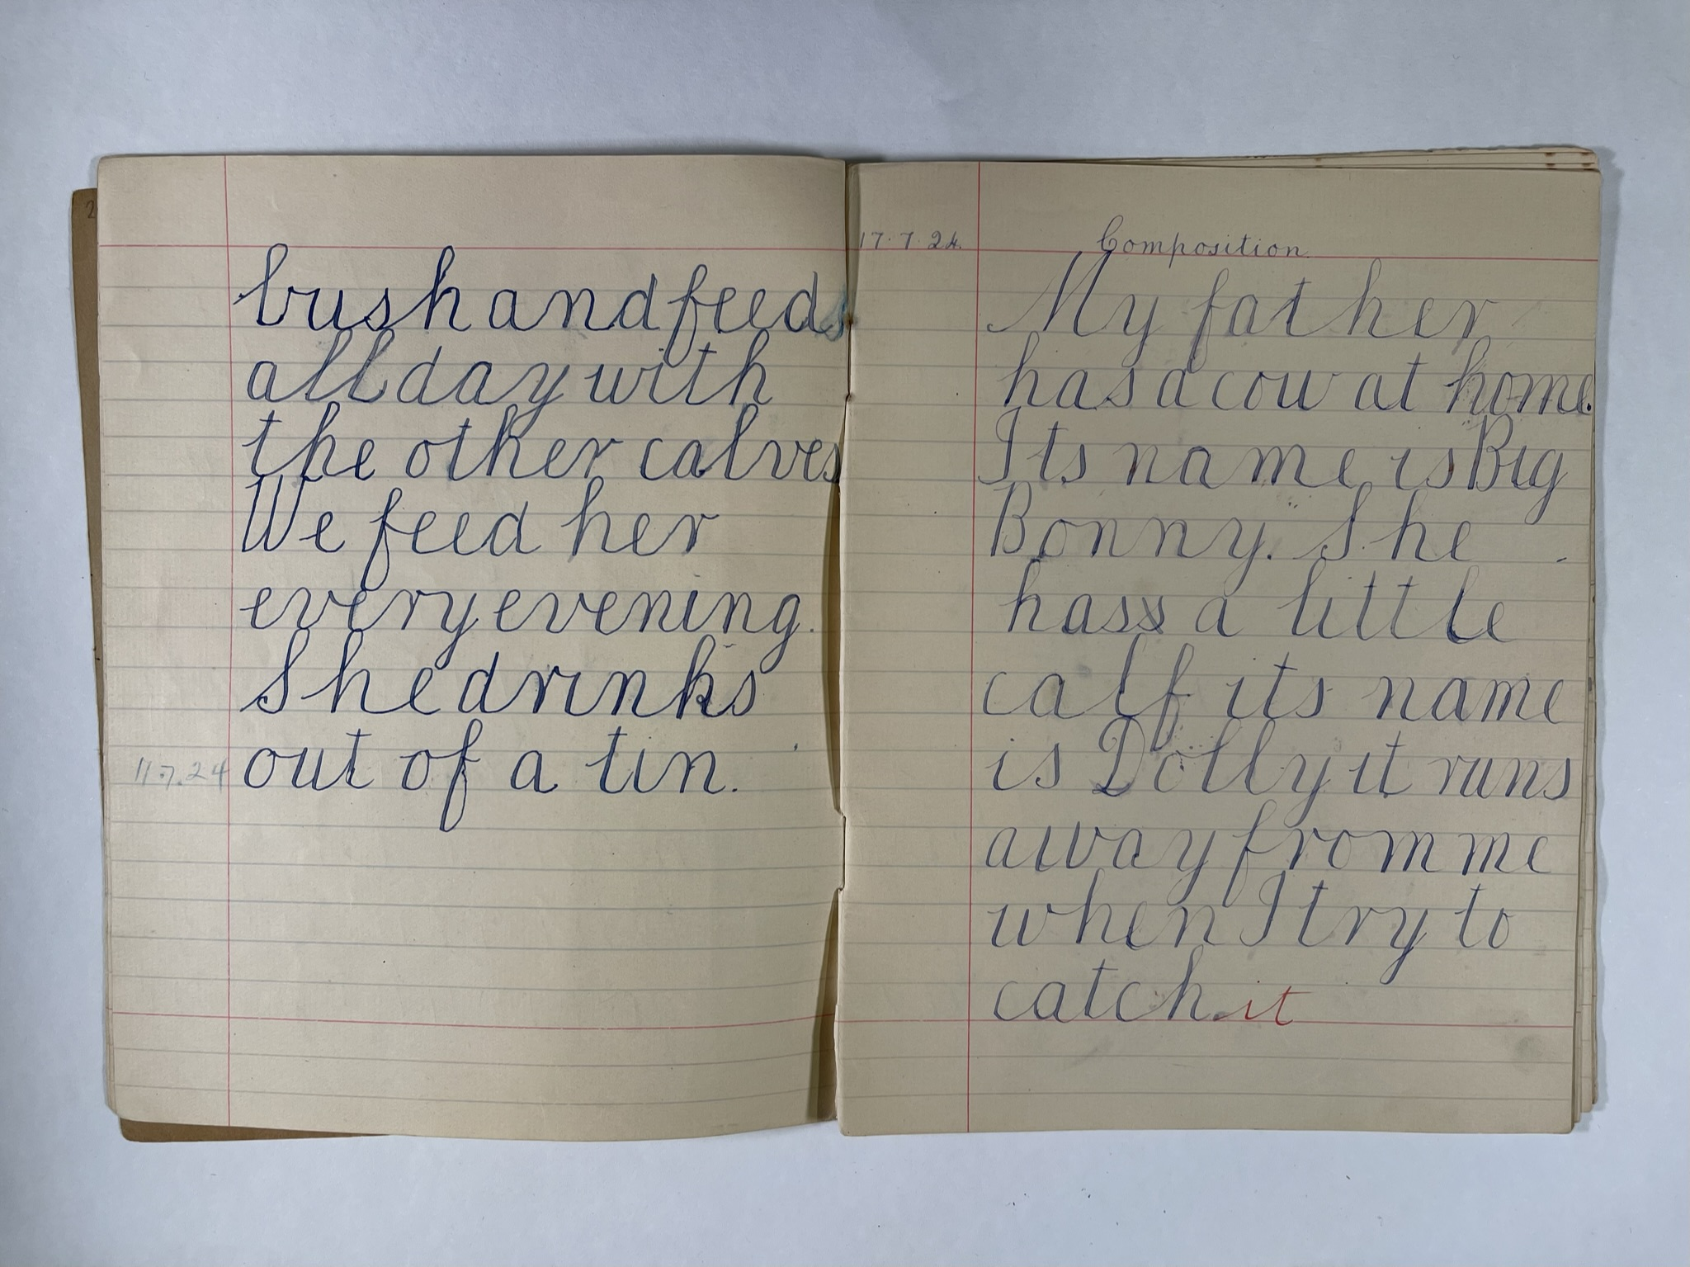
Notes:
My father has a cow at home. It’s name is Big Bonny. She has a little calf it’s name is Dolly it runs away from me when I try to catch it.
Why do you think Alma was writing about farm animals such as ducks and cows?
Children that attended the Wanneroo schools often came from a farming family. Therefore farm animals would have been a common writing topic.

Slide 21
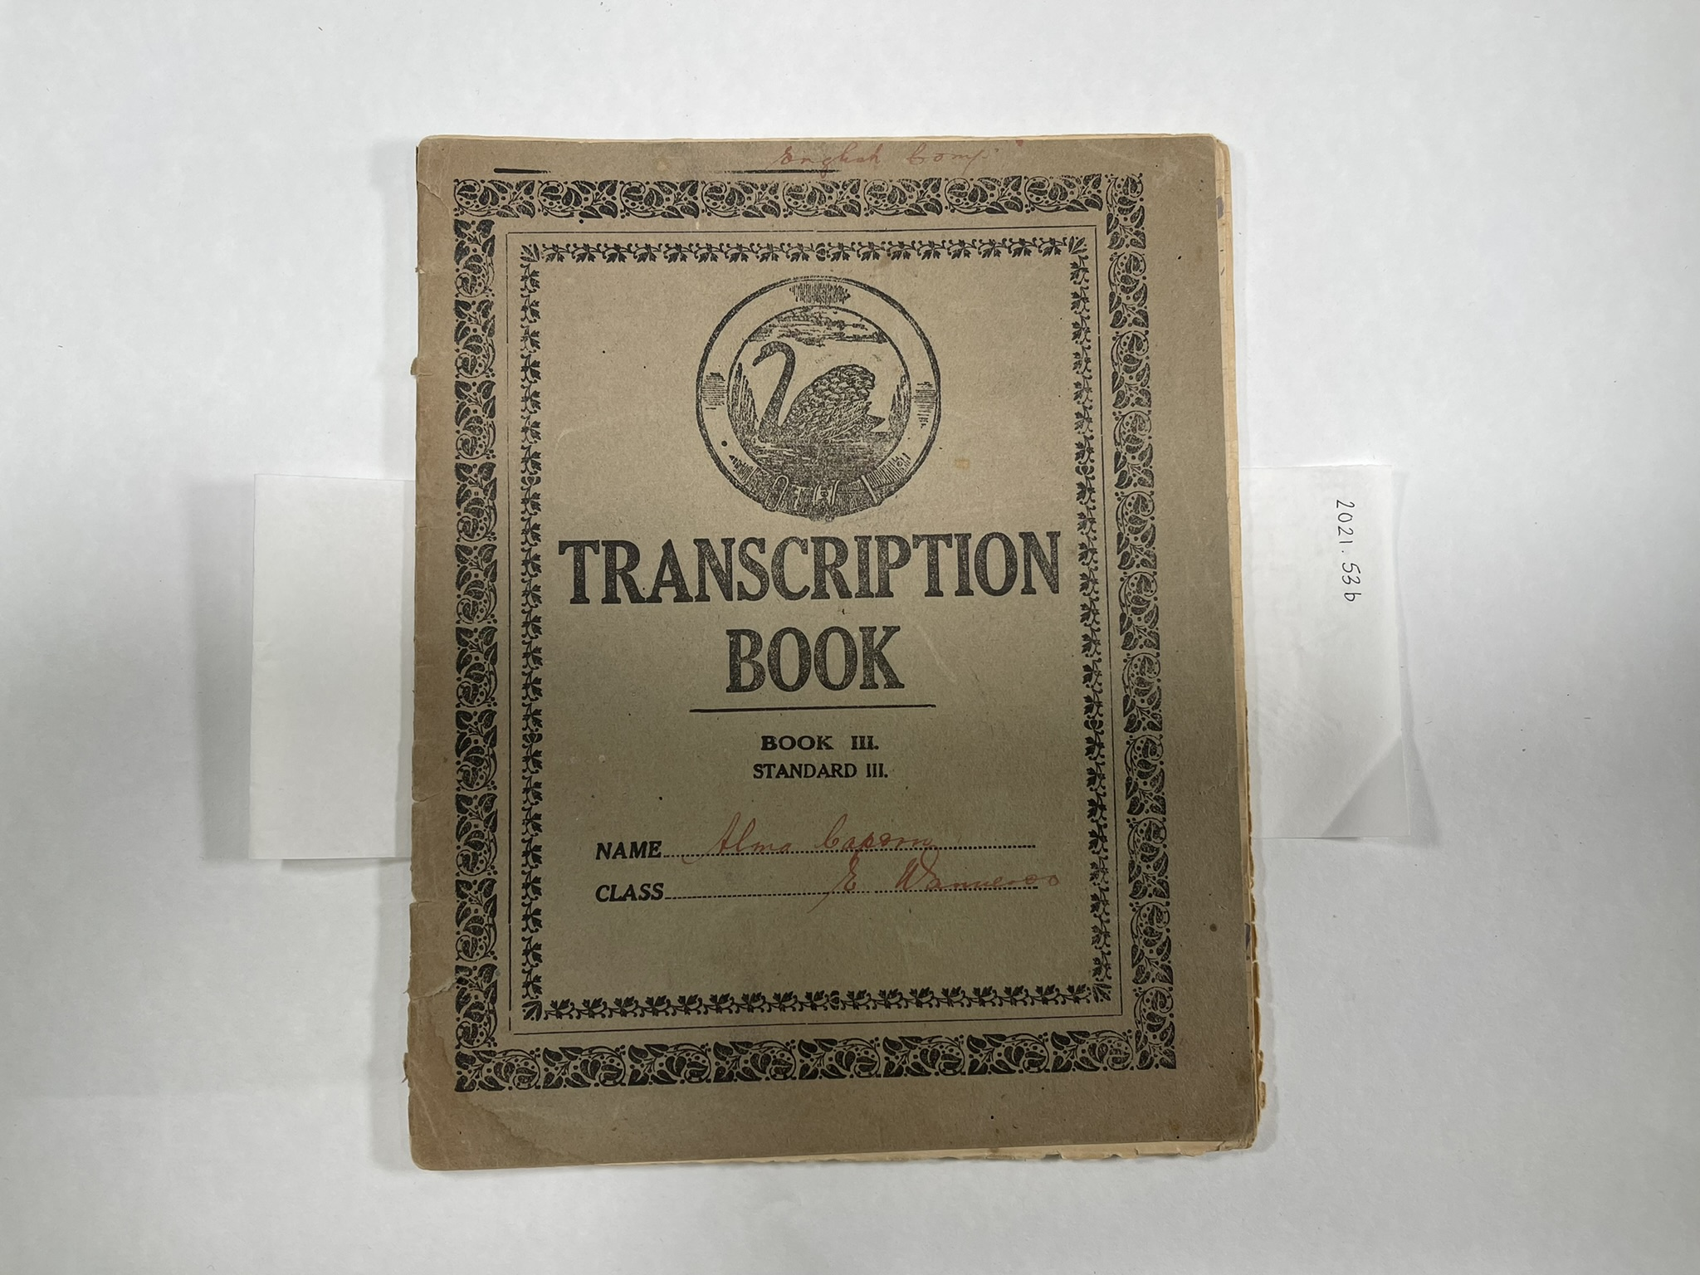
Notes:
Alma Caporn’s transcription book. (1920s) Transcription writing involves copying down text. In this book Alma has had some lessons in grammar

Slide 22
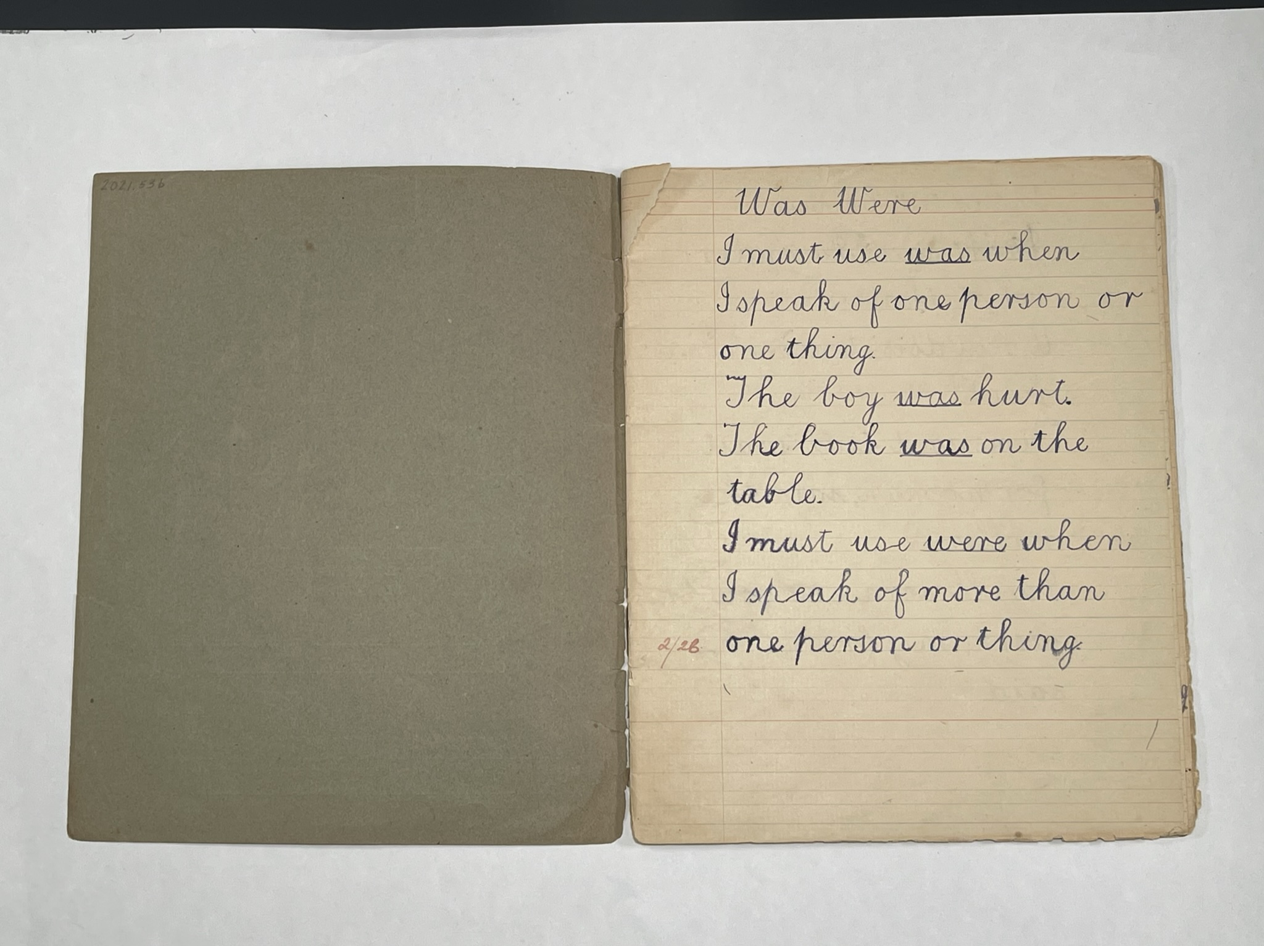
Notes:
Was Were
I must use was when I speak of one person or thing.
The boy was hurt. The book was on the table.
I must use were when I speak of more than one person or thing.
Alma was 10 when this was written. What differences can you see in her writing?

Slide 23
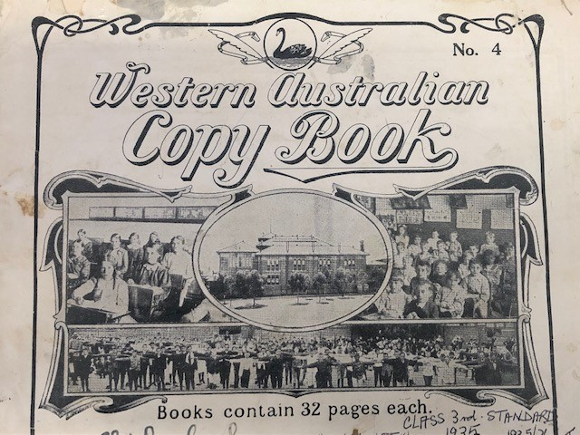
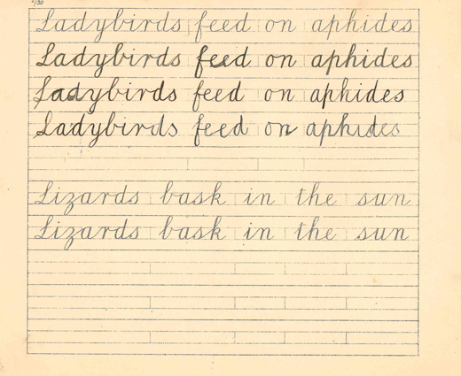
Notes:
Students also used something called a copy book. They had to practise their writing by copying the sentences in the book. Their aim was to write neatly and quickly.

Slide 24
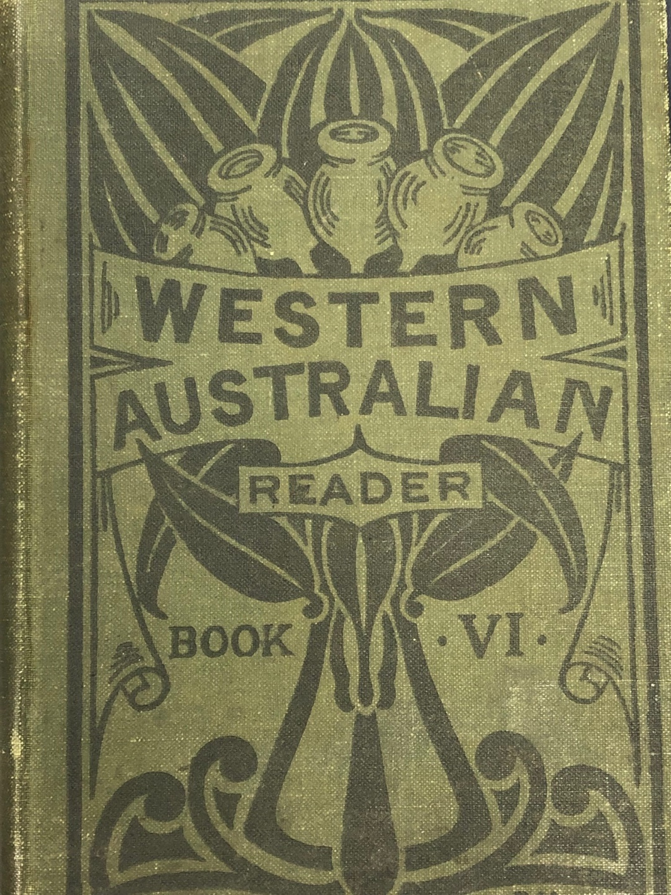
Notes:
In school students read from books called readers. Oxford Readers and Temple Literary Readers had a lot of British content in them. In 1916 Western Australia Readers were created and in 1920 Swan Readers. They had more of a balance of both Australian and British content. Reading and memorising poetry was a part of lessons too.

Slide 25
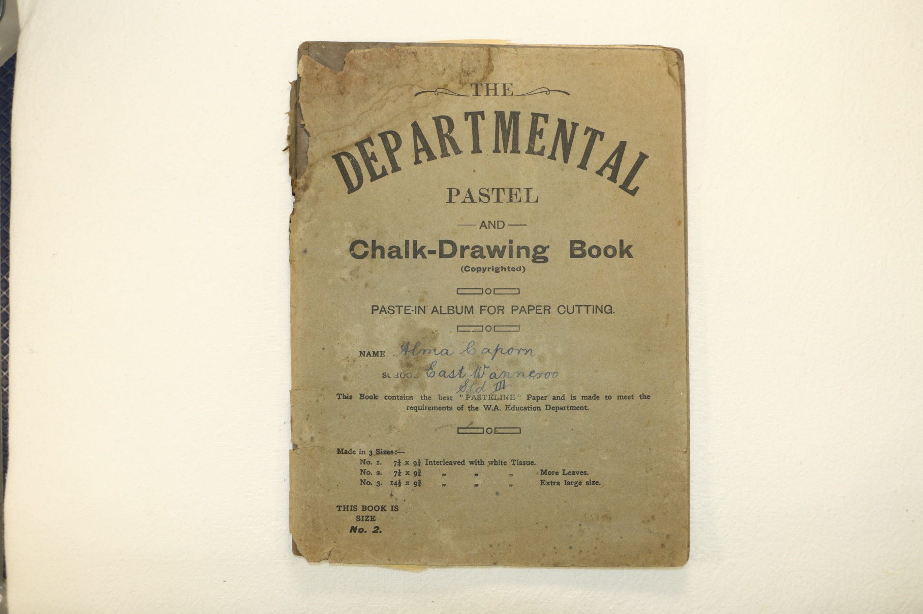
Notes:
Alma Caporn’s chalk drawing book. (1920s) Have a look at the following slides and see what sorts of objects Alma used in an art lesson.

Slide 26
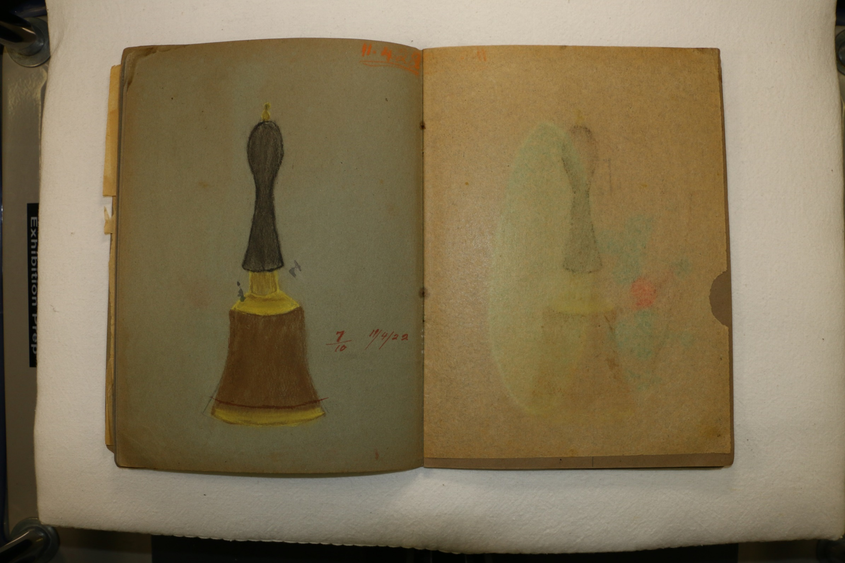

Slide 27
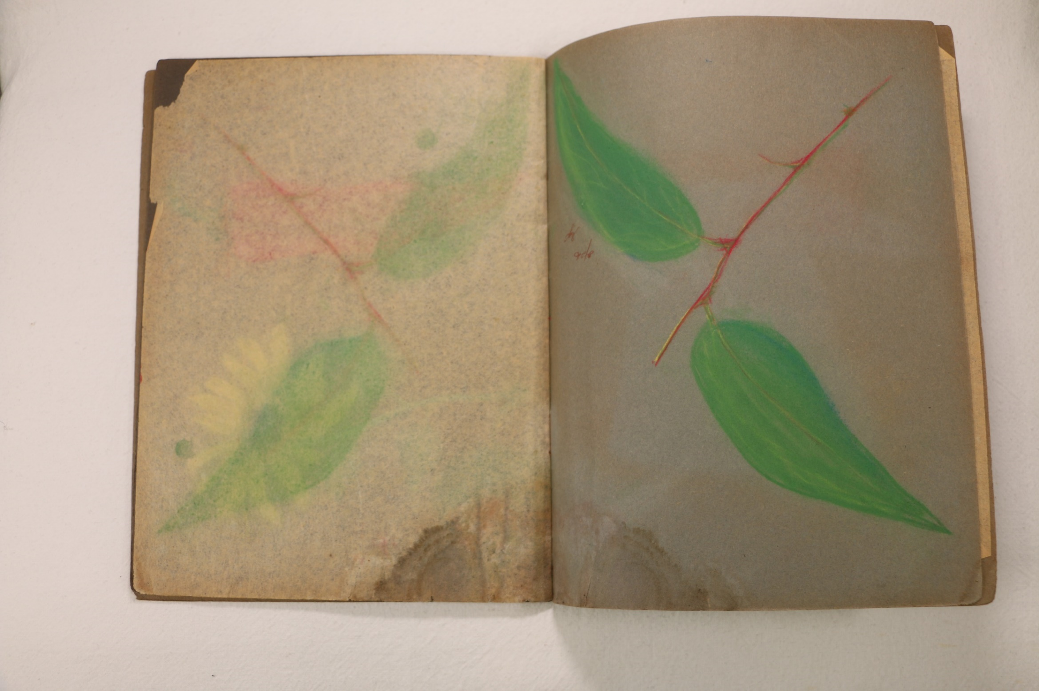

Slide 28
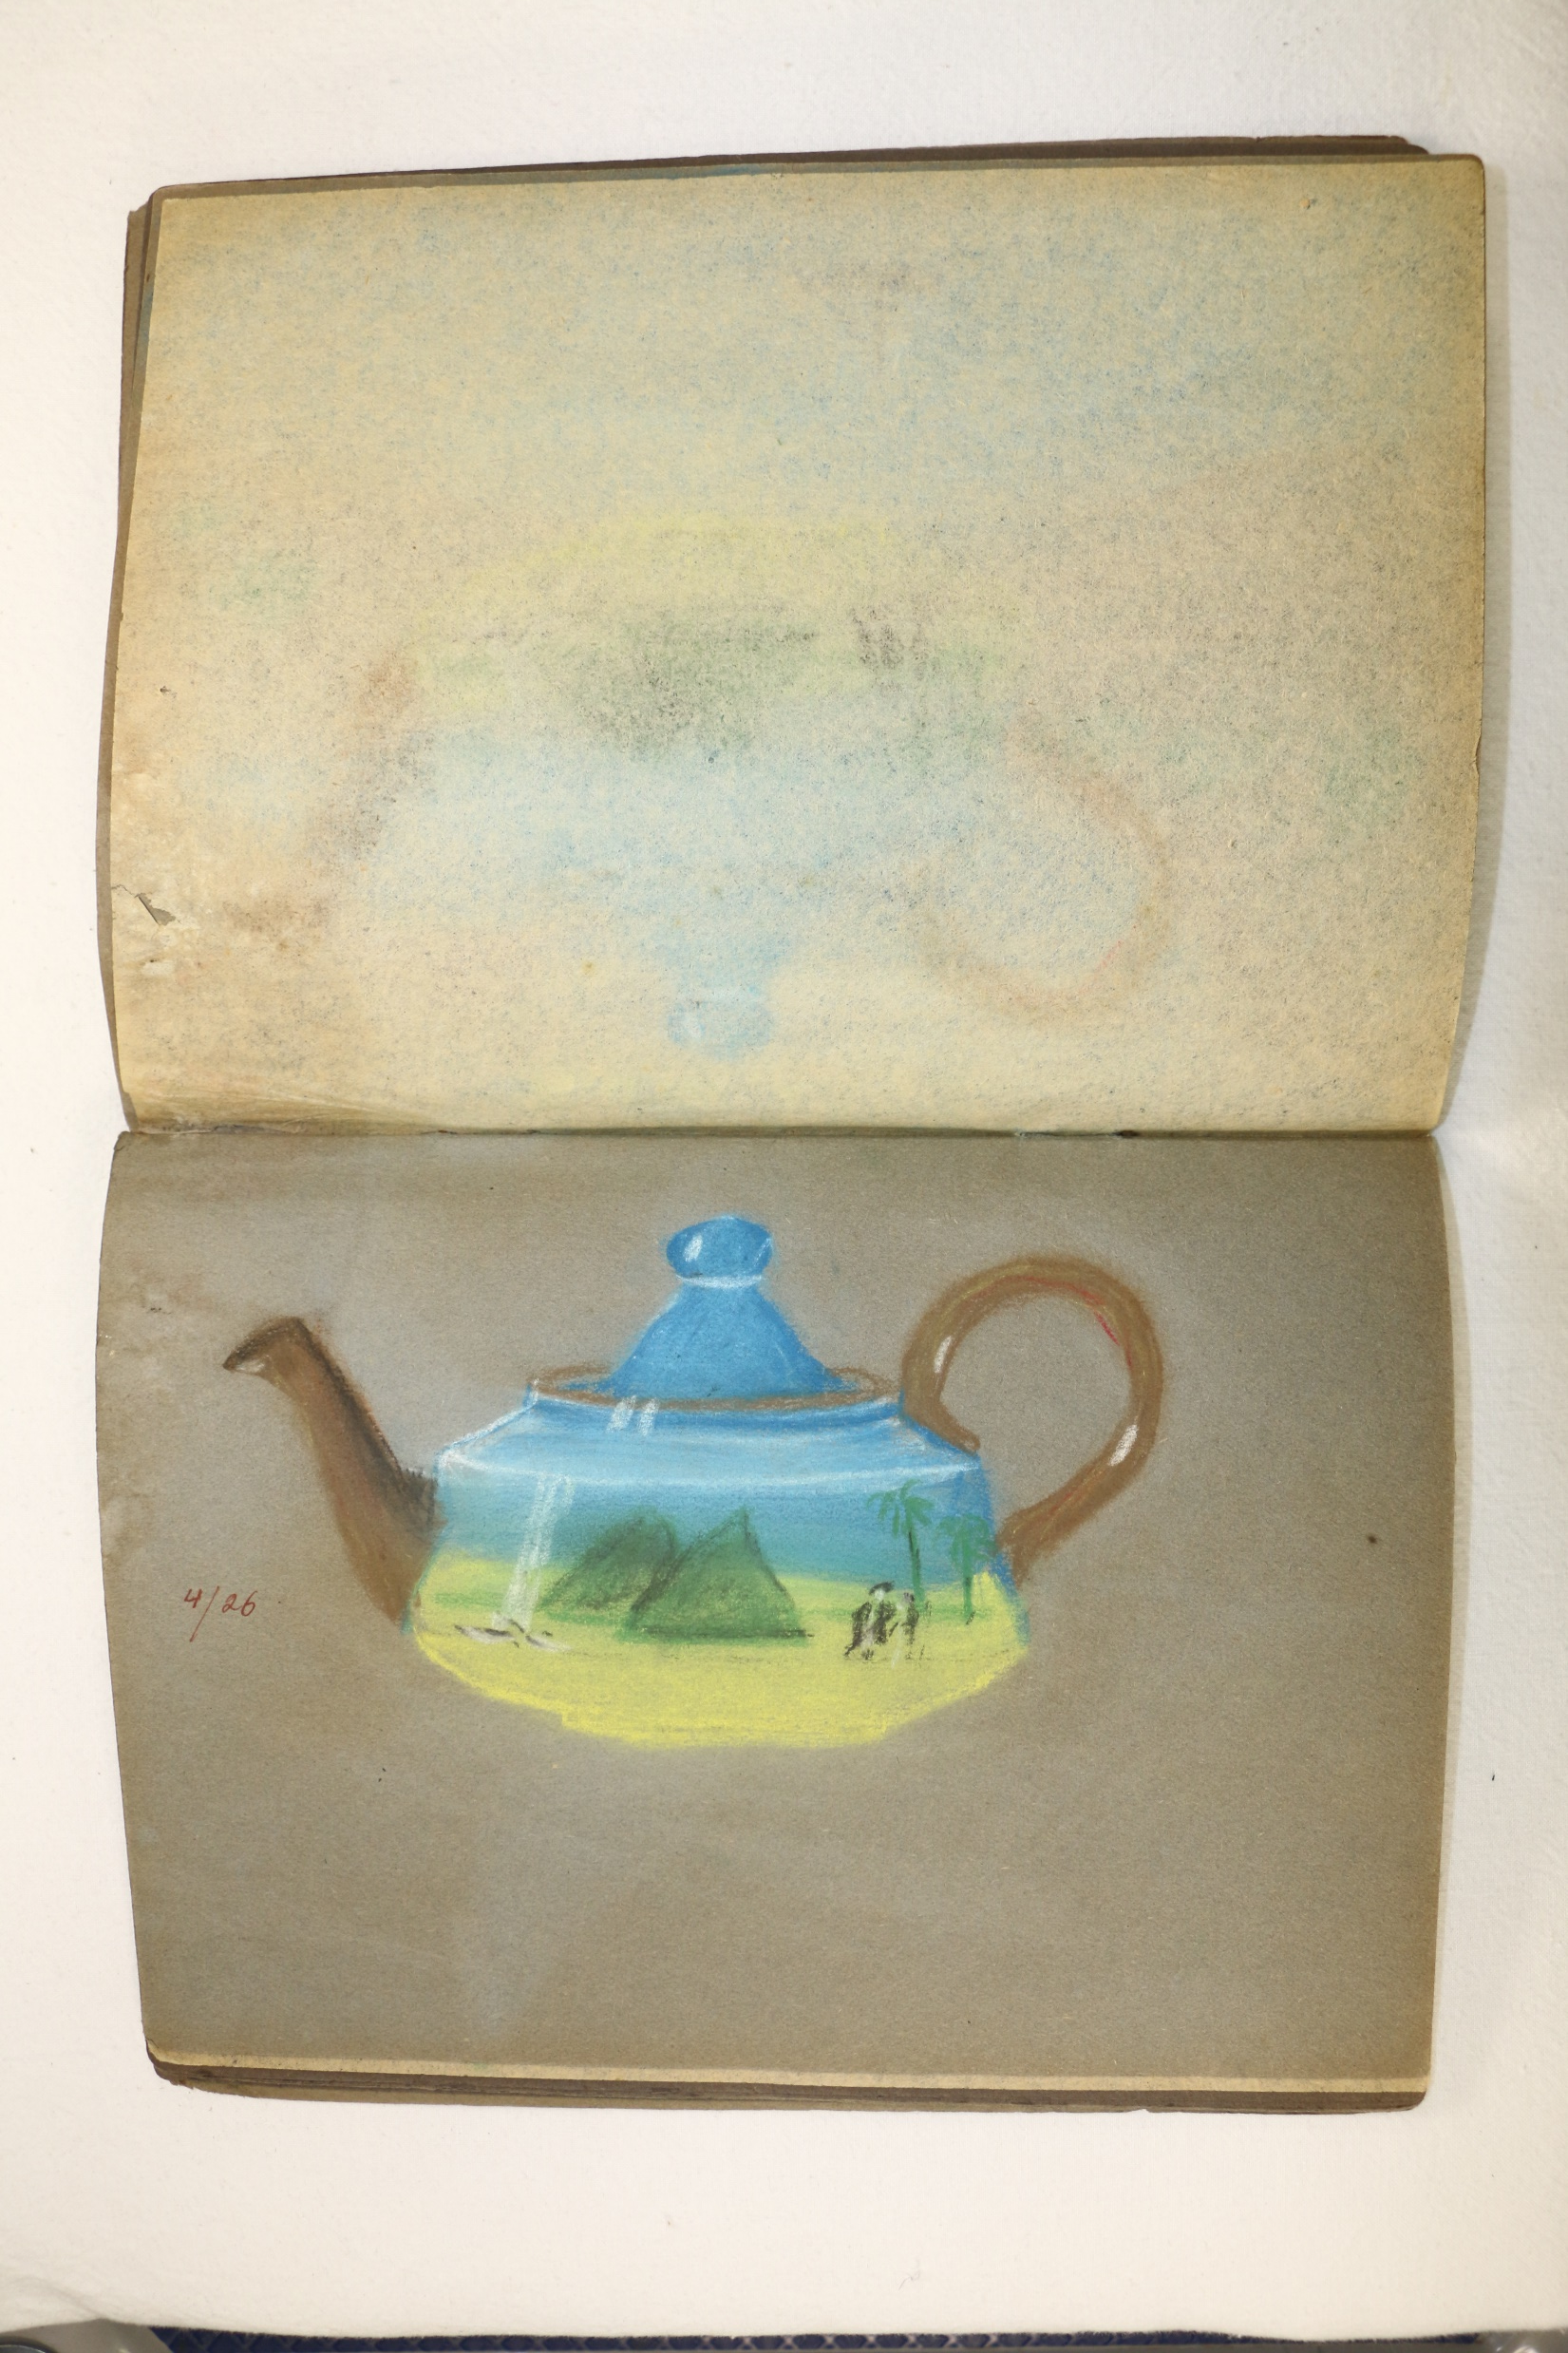

Slide 29
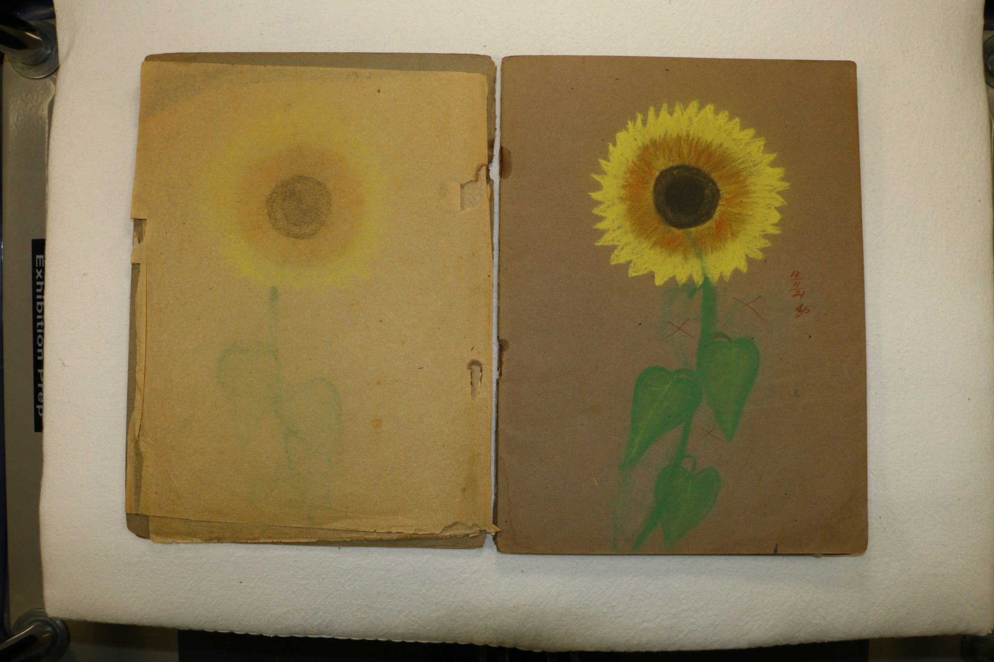

Slide 30
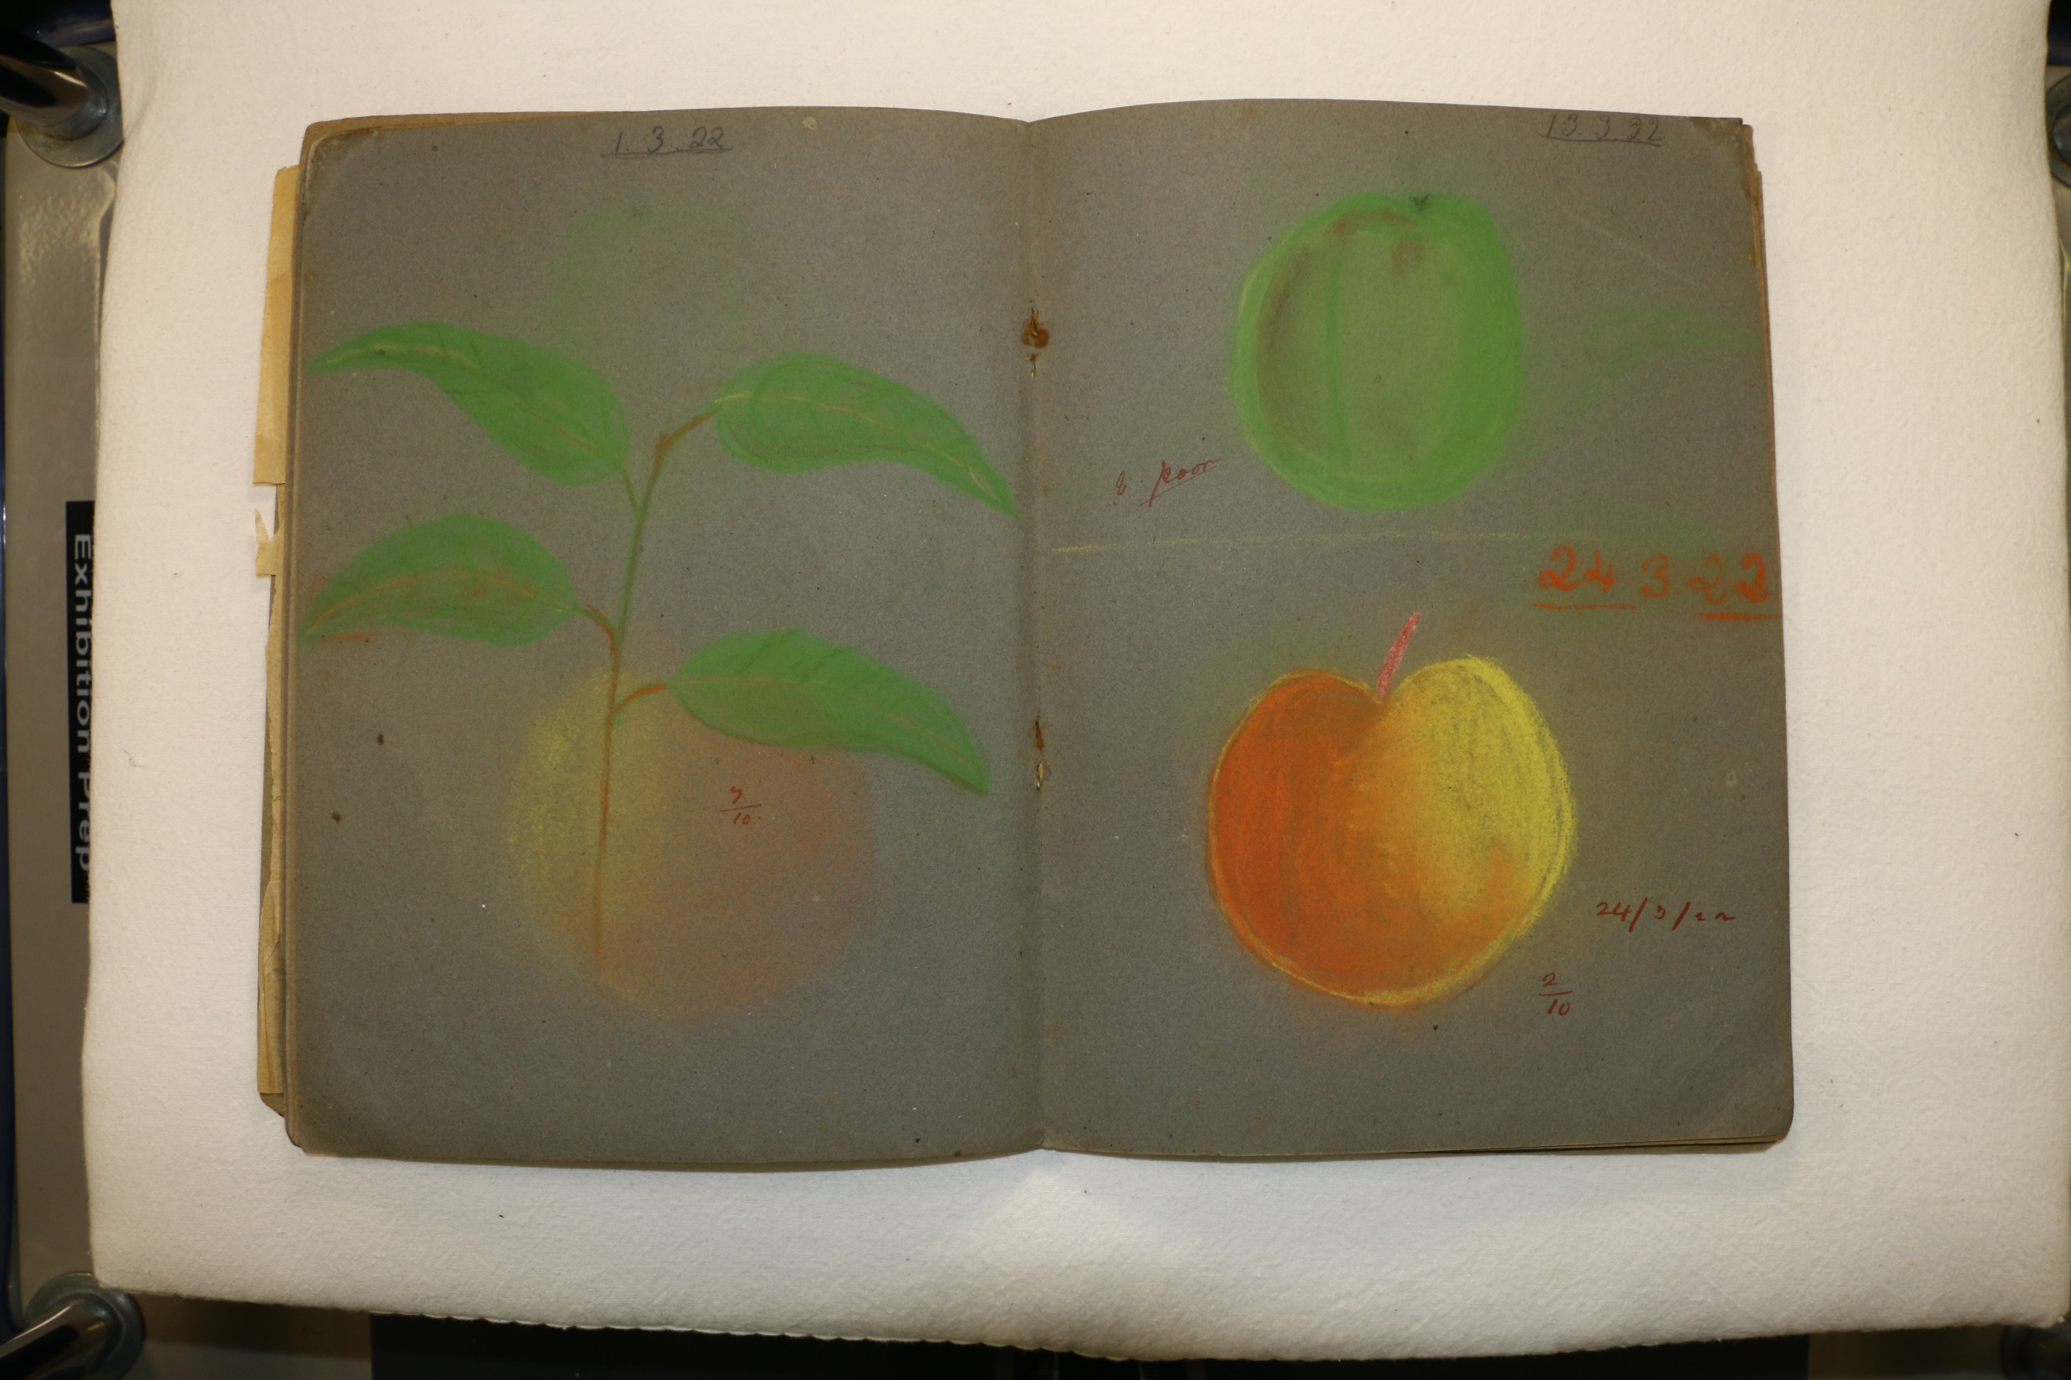

Slide 31
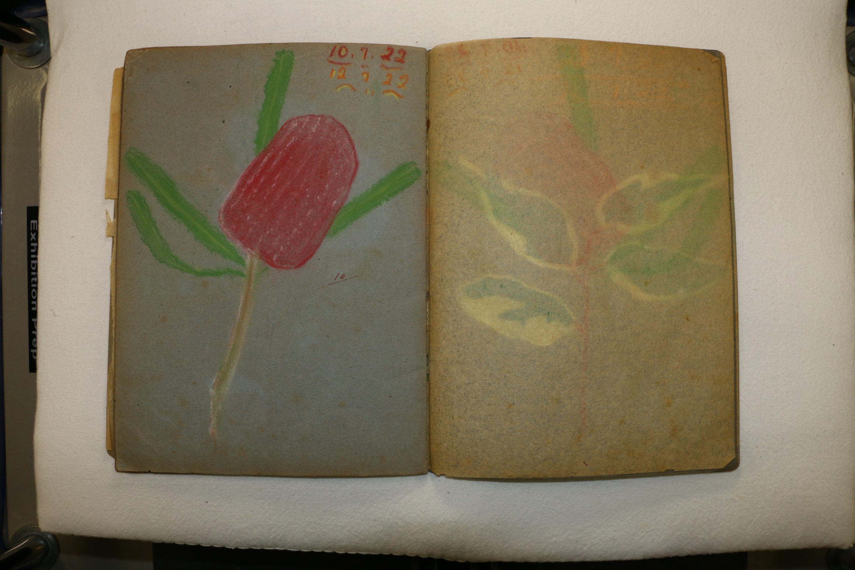

Slide 32
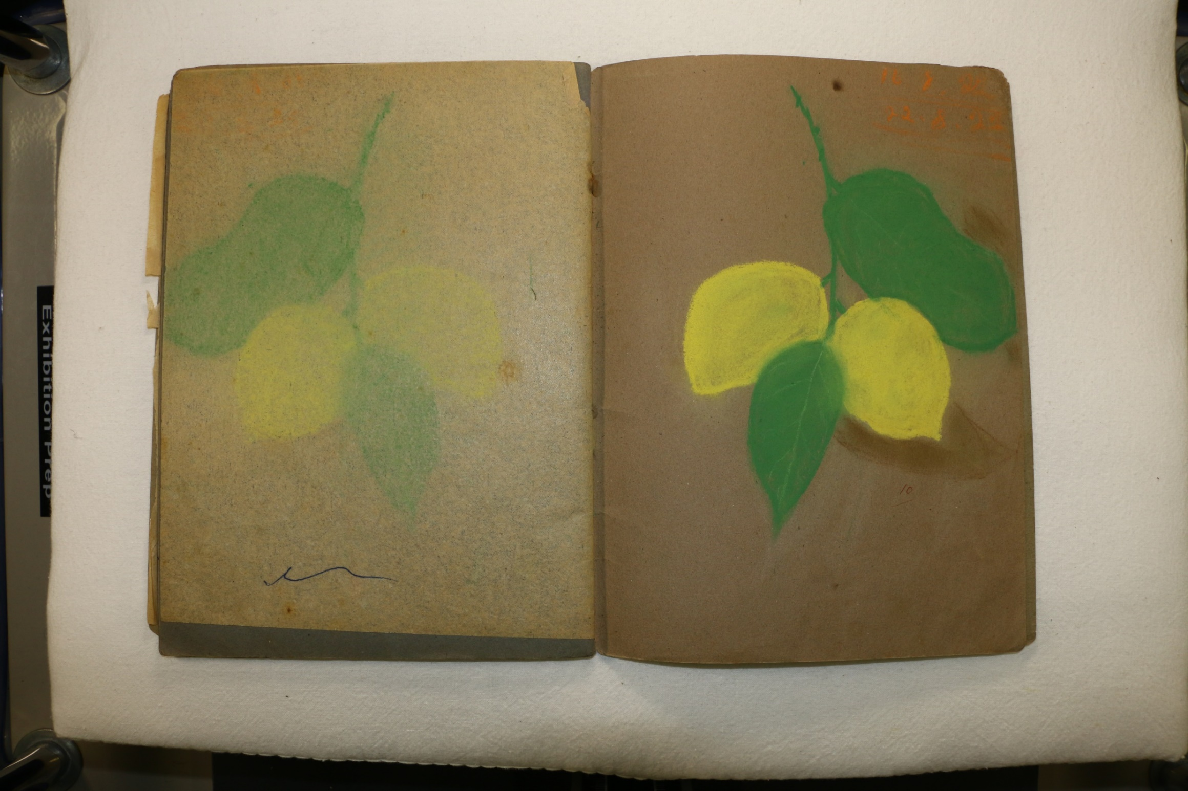

Slide 33
Please click links to access
Old School Days in Wanneroo videos
Education resources
Virtual tour
Photographs courtesy of the Wanneroo Regional Museum and Community History Centre.

