Slide 1
Volunteer induction

Slide 2
Induction for community members volunteering in Committees and Advisory / Working Groups

Slide 3
Welcome to the City
Welcome to the City of Wanneroo and thank you for offering to give of your time and energy to make the city a better place to live, work and play.
Regardless of where you will be volunteering, or which group you are involved with, you are part of our City of Wanneroo family and we are thankful for your contribution.
This induction will introduce you to our organisational culture, structures and systems.

Slide 4
General benefits to volunteering
Volunteering benefits
act on your values, passions and interests.
make new friendships and create professional networks.
gain work experience and learn new skills.
enjoy new social and cultural experiences.
develop personally and build confidence.
enjoy better physical and mental health.
Volunteering has many personal and professional benefits and we hope you will experience some of them during your involvement in the City.

Slide 5
Volunteering benefits
General benefits to volunteering
act on your values, passions and interests.
make new friendships and create professional networks.
gain work experience and learn new skills.
enjoy new social and cultural experiences.
develop personally and build confidence.
enjoy better physical and mental health.
Volunteering has many personal and professional benefits and we hope you will experience some of them during your involvement in the City.

Slide 6
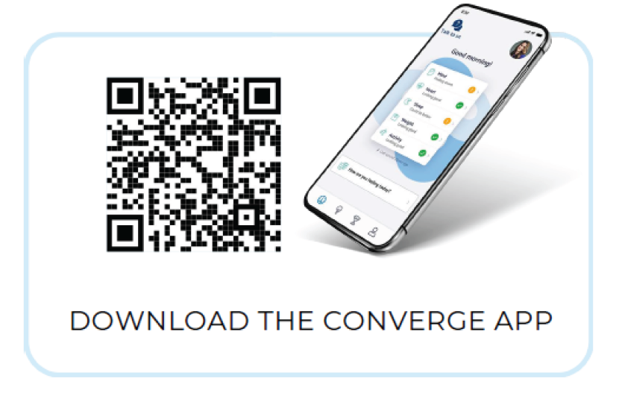
City of Wanneroo benefits
Employee Assistance Program (EAP) provision
The City of Wanneroo offers a range of Employee Assistance resources to its team members.
You can access EAP Counselling, Crisis Counselling Support and a broad range of mental health resources
Call 1300 OUR EAP (1300 687 327)
Download the Converge App using the QR code to book online. Use app access code: CITYJNUI
Visit www.convergeinternational.com.au for online resources and the live chat function
Volunteer communication and training
You will receive our regular Volunteer News to ensure you are up to date with important City news, upcoming offers to training/ upskilling opportunities and sharing good news stories from across the city and volunteer program.

Slide 7
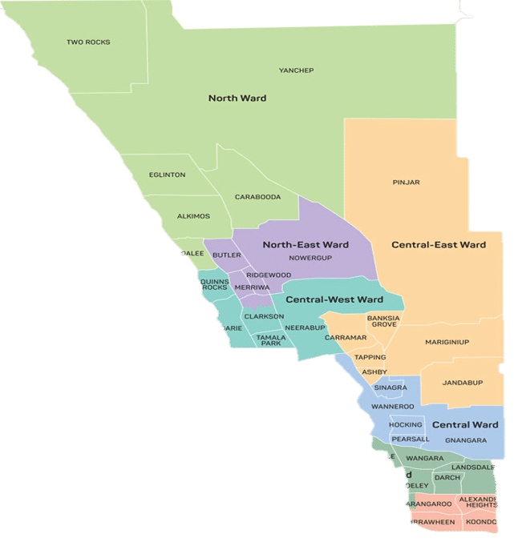
You have joined one of Australia’s fastest growing councils, currently including 36 suburbs with 213,00 residents calling it home. This is estimated to grow to 370,000 residents by 2041.
The City of Wanneroo is a democratically led organisation that consists of an elected Mayor and 14 Councillors. One Councillor is also elected as Deputy Mayor. Collectively, these 15 Members form the Council.
Representative Councillors are elected to their respective wards. The Mayor and local Councillors represent the views and opinions of all residents and ratepayers within the City.
City of Wanneroo

Slide 8
City of Wanneroo
You have joined one of Australia’s fastest growing councils, currently including 36 suburbs with 213,00 residents calling it home. This is estimated to grow to 370,000 residents by 2041.
The City of Wanneroo is a democratically led organisation that consists of an elected Mayor and 14 Councillors. One Councillor is also elected as Deputy Mayor. Collectively, these 15 Members form the Council.
Representative Councillors are elected to their respective wards. The Mayor and local Councillors represent the views and opinions of all residents and ratepayers within the City.
IMAGE HERE

Slide 9
Our Vision:
A welcoming community, connected through local opportunities.
Our City
Our Purpose:
To create a strong community with local opportunities to participate, be active, feel secure, contribute and belong
Our Values:
Customer Focus: Delivering service excellence
Improvement: Finding simpler, smart and better ways of working
Accountability: Accepting responsibility and meeting commitments, on time and to standard
Collaboration: Together we are stronger
Respect: Trusting others and being trustworthy

Slide 10
Our City
Our Vision:
A welcoming community, connected through local opportunities.
Our Purpose:
To create a strong community with local opportunities to participate, be active, feel secure, contribute and belong
Our Values:
Customer Focus: Delivering service excellence
Improvement: Finding simpler, smart and better ways of working
Accountability: Accepting responsibility and meeting commitments, on time and to standard
Collaboration: Together we are stronger
Respect: Trusting others and being trustworthy

Slide 19
The City of Wanneroo is committed to a work environment that is free from inappropriate conduct including bullying, harassment, discrimination and victimisation; and aim toward an environment where individuals are treated fairly, with dignity, equally and with respect in accordance with the City’s Code of Conduct and Corporate Values.
Your Committee Coordinating Officer has provided you with a Code of Conduct in your Induction Pack. Please ensure you have read and understood this document. You will be asked to sign a copy at your first committee / working group meeting
Code of Conduct

Slide 20
Code of Conduct
The City of Wanneroo is committed to a work environment that is free from inappropriate conduct including bullying, harassment, discrimination and victimisation; and aims toward an environment where individuals are treated fairly, with dignity, equally and with respect in accordance with the City’s Code of Conduct and Corporate Values.
Your Committee Coordinating Officer has provided you with a Code of Conduct in your Induction Pack. Please ensure you have read and understood this document. You will be asked to sign a copy at your first committee / working group meeting

Slide 21
Work, Health and Safety
Keeping our people safe is a strong focus in the City of Wanneroo.
To ensure you are safe and unharmed during your volunteering, please ensure to adhere to a few guiding principles:
Always wear safety equipment (PPE) if required for your role
Only operate equipment you have been trained and authorised to use
Report injuries and hazards to your leader immediately
Ensure you are drug and alcohol free. The possession or use of illegal drugs on site is prohibited

Slide 22
Work, Health and Safety
Keeping our people safe is a strong focus in the City of Wanneroo.
To ensure you are safe and unharmed during your volunteering, please ensure to adhere to a few guiding principles:
Always wear safety equipment (PPE) if required for your role
Only operate equipment you have been trained and authorised to use
Report injuries and hazards to your leader immediately
Ensure you are drug and alcohol free. The possession or use of illegal drugs on site is prohibited
IMAGE HERE

Slide 23
Please watch this short video
Manual Handling

Slide 24
Manual Handling
Please watch this short video

Slide 25
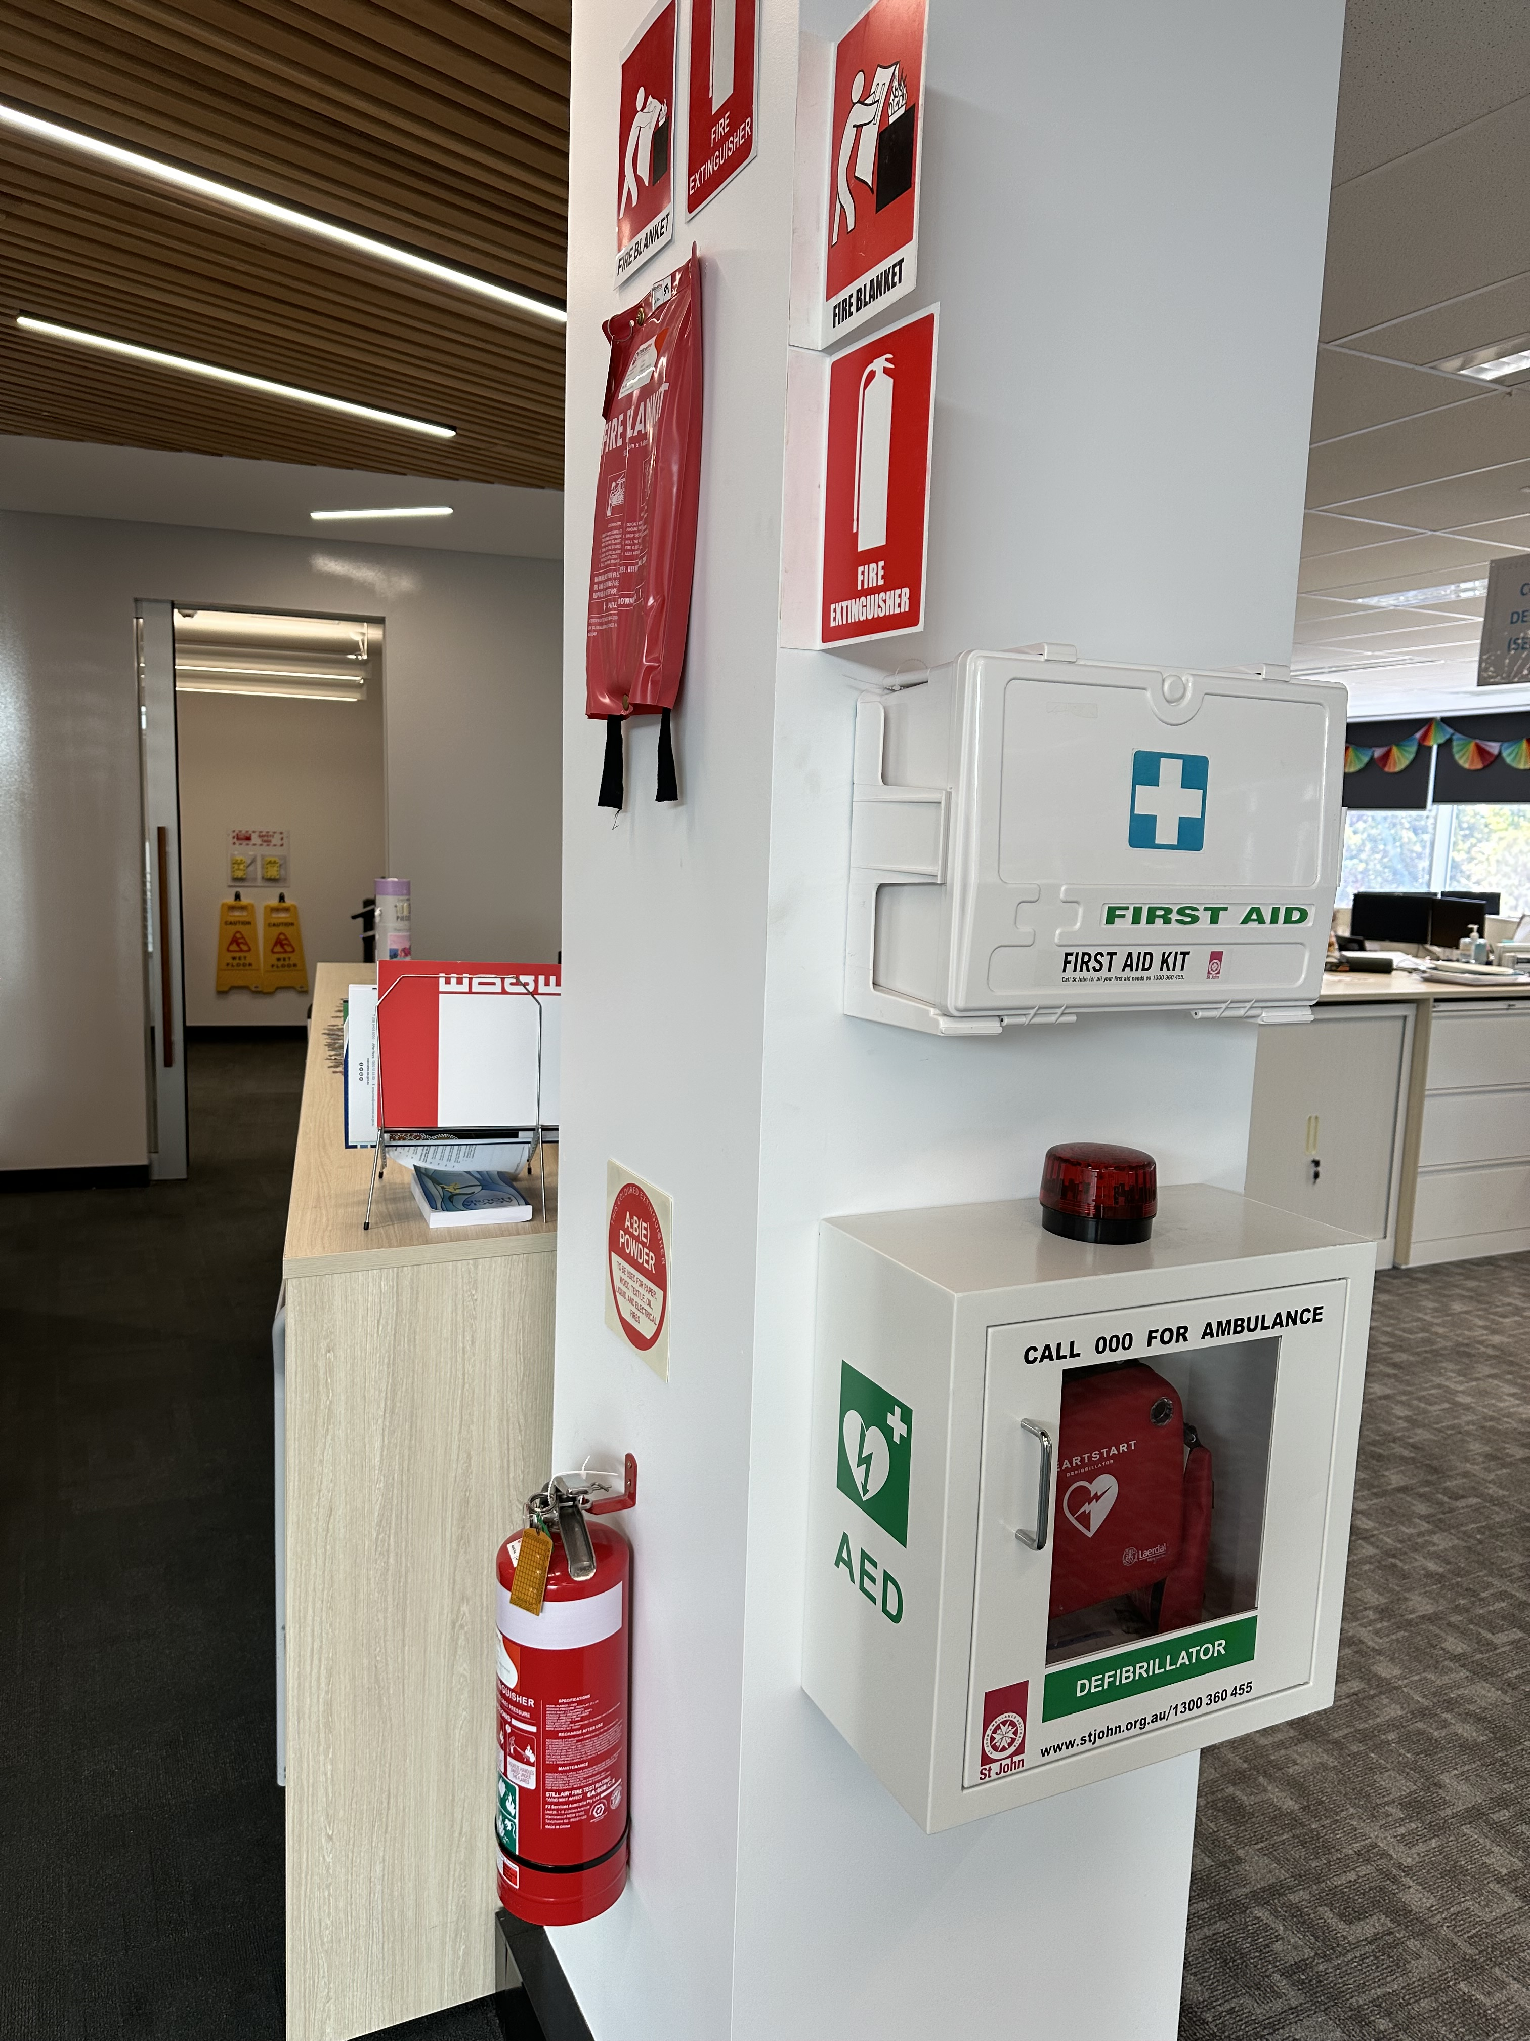
Emergency information and First Aid
All City of Wanneroo buildings are equipped with Emergency tools and signage. These will be pointed out to you at your first meeting.
Please familiarise yourself with the location of first aid stations, emergency exits, defibrillator locations and the Facility Wall plans.
Ensure to update your personal details and Emergency Contact information when required.

Slide 26
Emergency information and First Aid
All City of Wanneroo buildings are equipped with Emergency tools and signage. These will be pointed out to you at your first meeting.
Please familiarise yourself with the location of first aid stations, emergency exits, defibrillator locations and the Facility Wall plans.
Ensure to update your personal details and Emergency Contact information when required.

Slide 27
for completing the Volunteer Induction.
We are looking forward to meeting you in person soon.
Should you have any questions or issues, please contact your group administrator.

